Slide 1
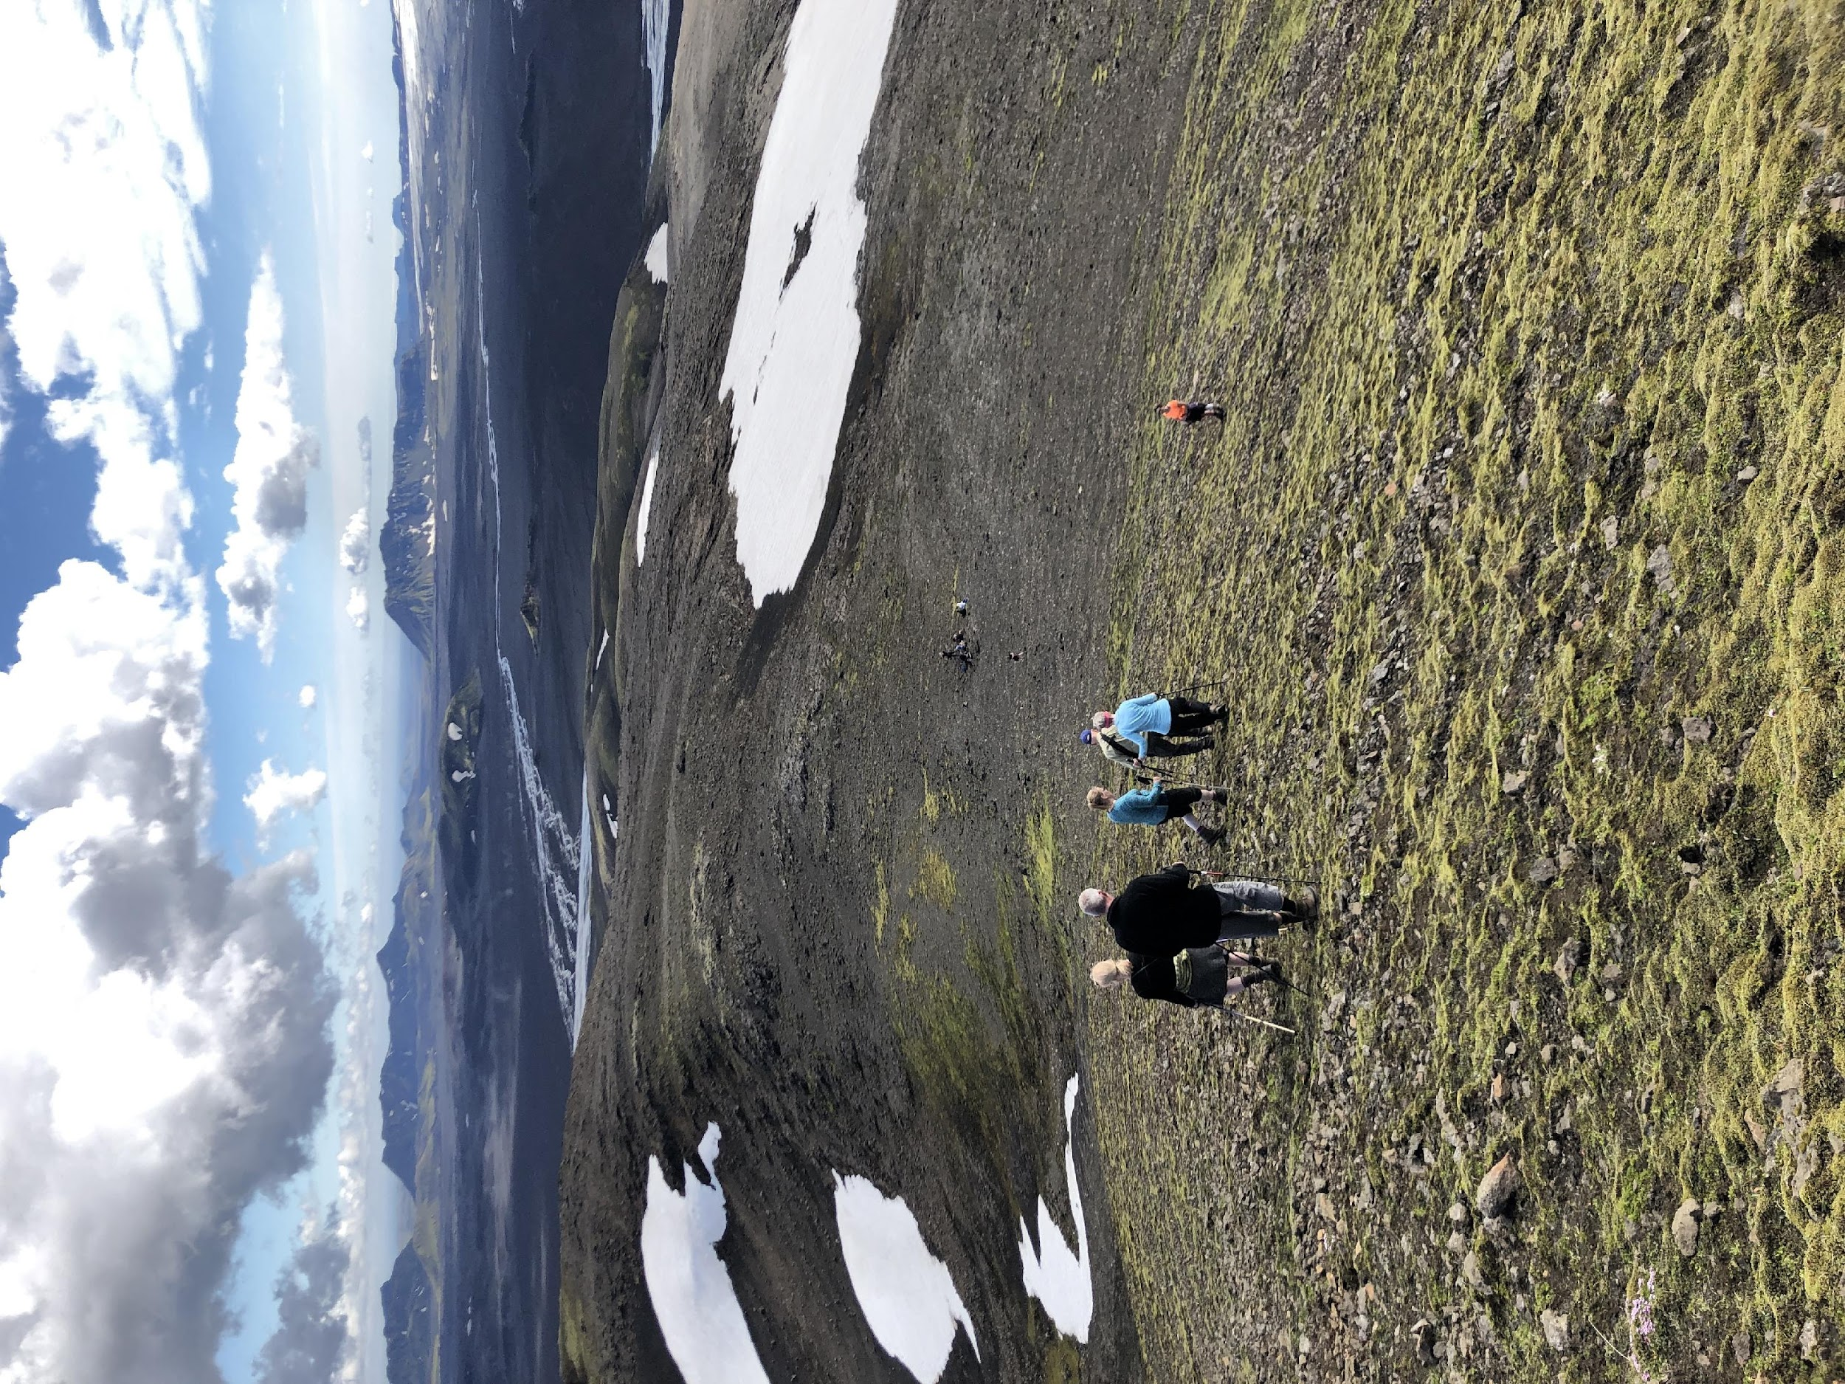
Module 3b
Sustainable Mountain
Tourism, Food and
Agriculture/Farming
Innovation

Slide 2
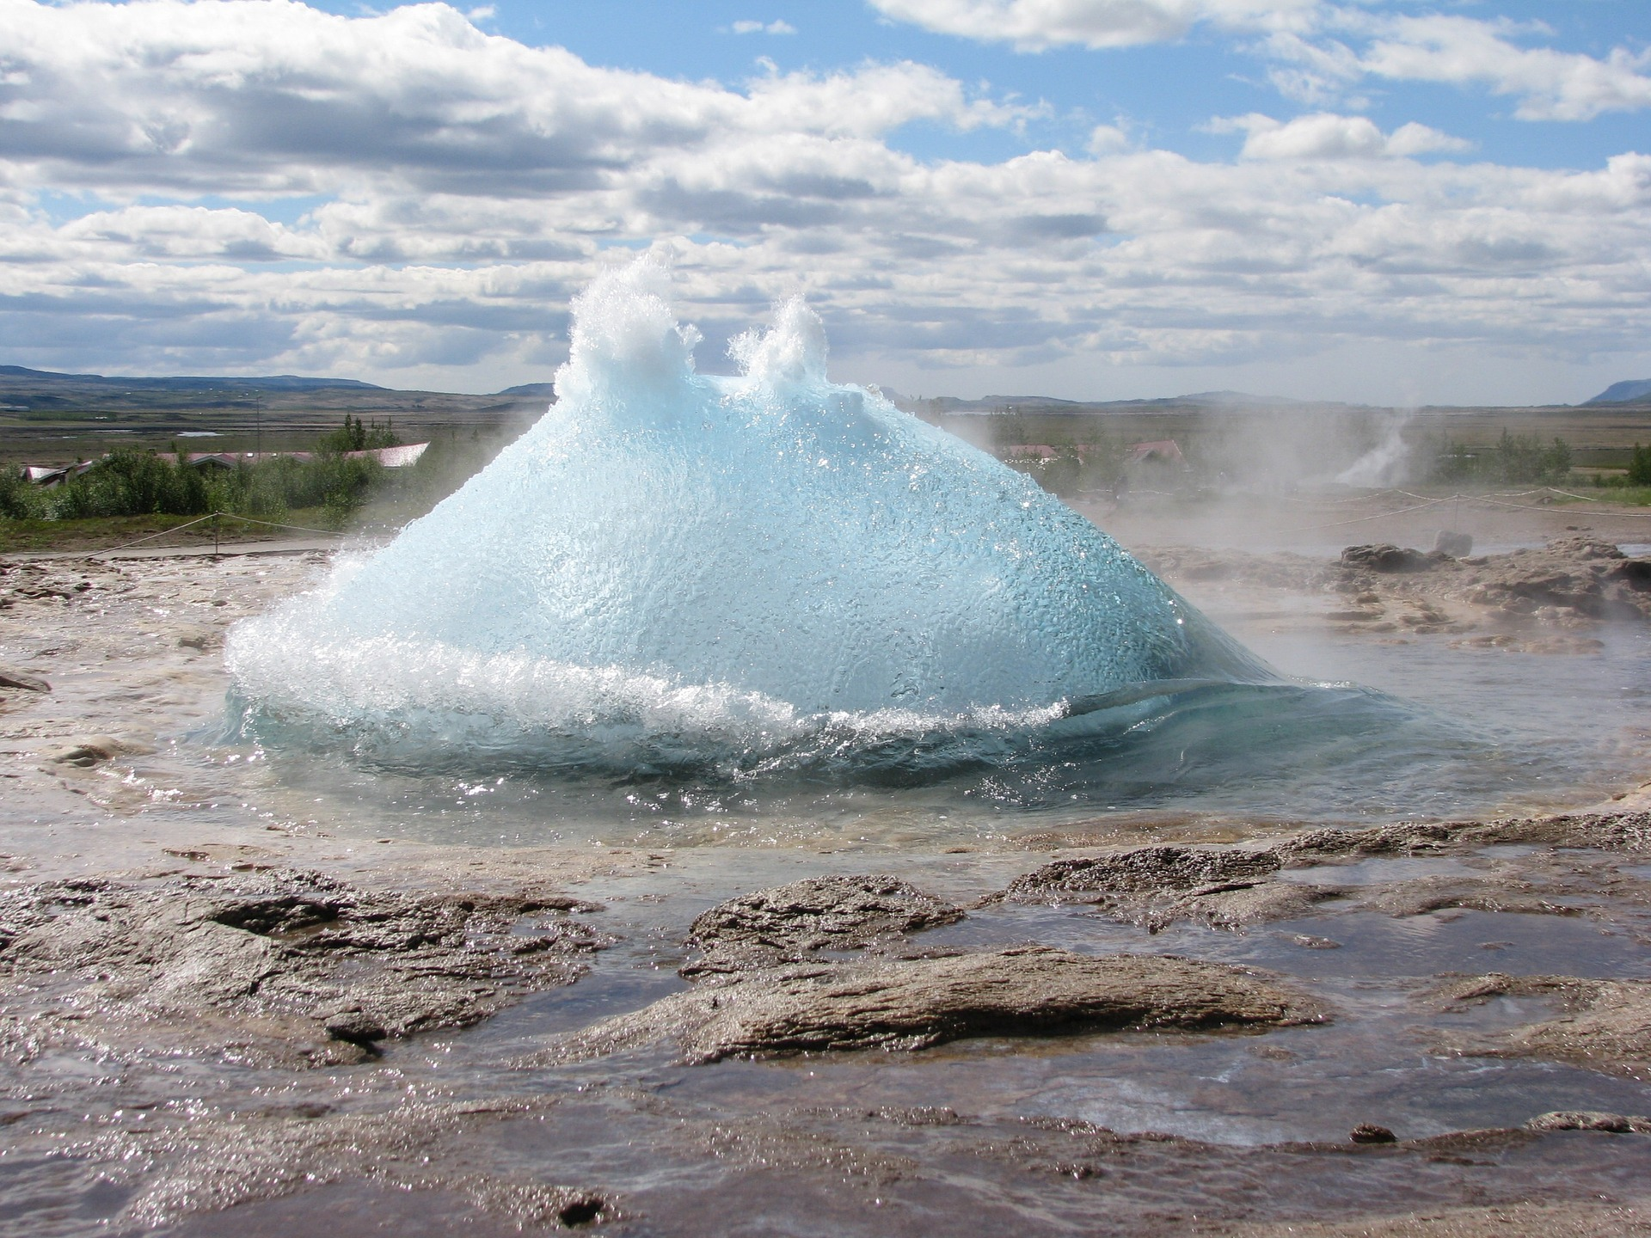
Introduction
This third module (3b) of the six-part PEAK course offers tools and analysis to:
Discuss opportunities and look at ideas built on sustainability and innovation to create and/or strengthen tourism companies in mountainous and rural areas.

Slide 3
LEARNING OBJECTIVES
At the end of this module,
you should be able to:
Identify underlying trends in tourism related to sustainability and customers motive for traveling.
Identify opportunities in ecological food production and its link with responsible tourism.
Apply their mountain business ideas into working methods of creative thinking and sustainability.

Slide 4
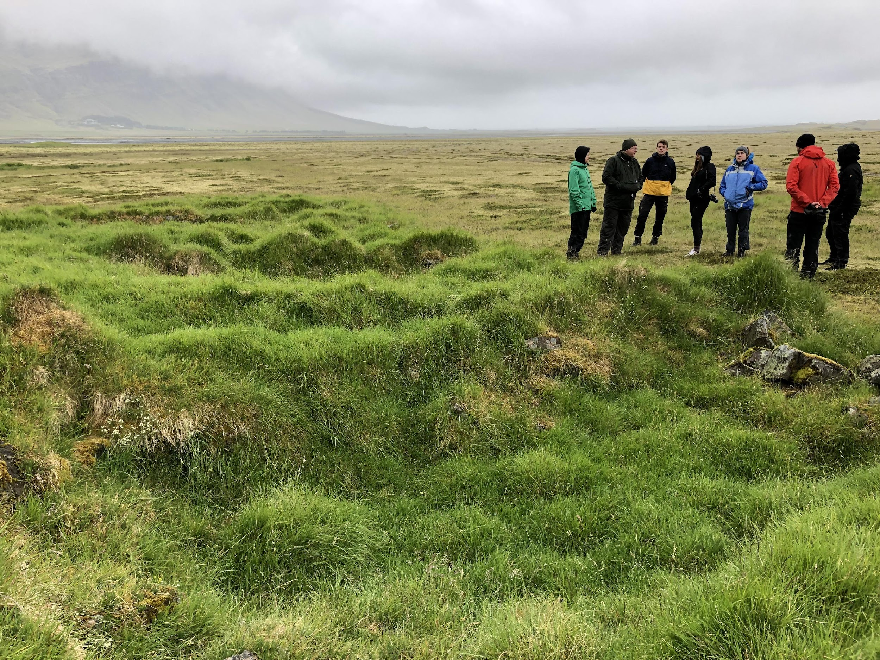
What is tourism?
"Tourism comprises the activities of persons traveling to and staying in places outside their usual environment for not more than one consecutive year for leisure, business and other purposes."
UNWTO - United Nations World Tourism Organization
"Around the world, in countries at all development levels, many millions of jobs and businesses are dependent on a strong and thriving tourism sector."
Zurab Pololikashvili, UNWTO Secretary-General
Notes:
Glossary of tourism terms | UNWTO

Slide 5

Innovation in Mountain Tourism
In tourism research, innovations are often categorized into types. One categorization used in such research is by Hjalager (2010) where innovations are divided into five types:
Product or service innovations (changes that can be directly observed by the tourist and other customers)
Process innovations (typically backstage initiatives aimed at improving efficiency and productivity)
Managerial innovations (new ways of organising business processes, empowering staff etc.)
Marketing innovations (new marketing concepts, such as loyalty programs)
Institutional innovations (new forms of collaborative structure, such as clusters, networks and alliances)
Notes:
Hjalager, A.M. (2010) A Review of Innovation Research in Tourism. Tourism Management, 31, 1-12. - References - Scientific Research Publishing (scirp.org)
https://www.scirp.org/(S(lz5mqp453ed%20snp55rrgjct55))/reference/referencespapers.aspx?referenceid=2411105

Slide 6
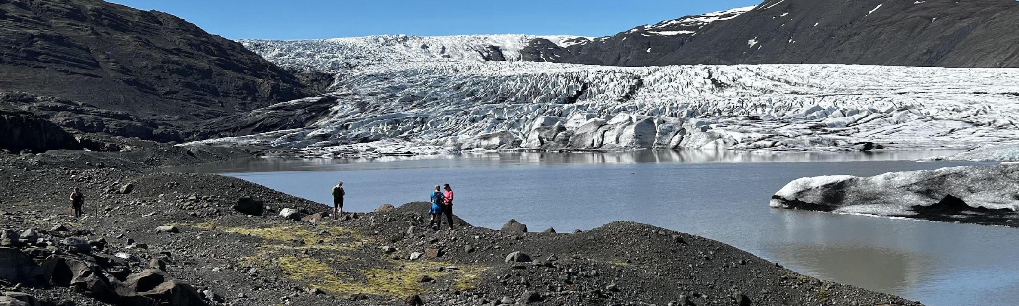
Are you a tourist operator in the mountains, wanting to create a new product or make an existing one better,
or
Do you want to become a mountain tourist operator?
Where might the opportunities lie?
Since 2018 transformative travel has been growing. It is any travel experience that empowers people to make meaningful, lasting changes in their lives.
Skift, 2018
The fastest growing travel trends in 2022:
Climate Resilience, Organised Solo Travel, Multi-generational Trips, Wellness Tourism and Culinary Travel.
Skift, Barrons & Forbes, 2022
All qualifying for responsible, sustainable travel in the mountains!
Notes:
Travel Trends for 2022 | Barron's (barrons.com)
https://www.barrons.com/articles/travel-trends-for-2022-01646339508
The Travel Trend Report 2022: The Experts Have Their Say, Part Two (forbes.com)
https://www.forbes.com/sites/angelinavillaclarke/2021/11/17/the-travel-trend-report-2022-the-experts-have-their-say-part-two/?sh=22582a953b48

Slide 7
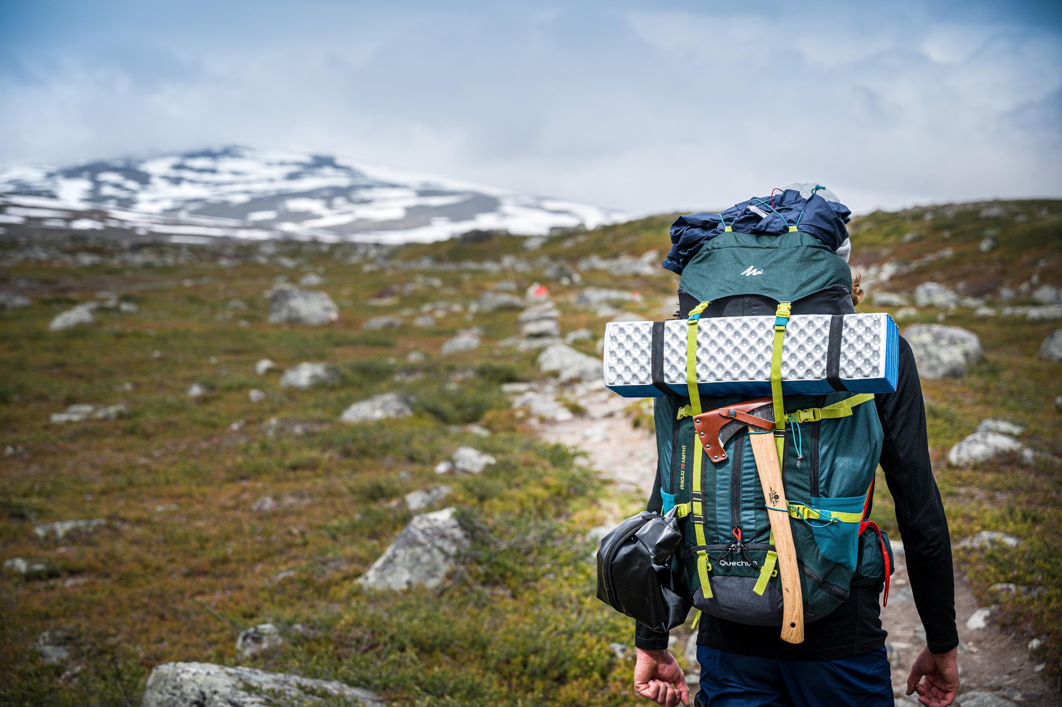

Lets look at Transformative Travel!
The experience consists of three essential elements that can easily be applied in mountainous areas:

Slide 8

Opportunities also lie in Responsible Tourism
Global Code of Ethics for Tourism (GCET)
" Tourism is a genuine driver of solidarity and development. Let us all fully harness its power to bring people and communities together, abiding by the Global Code of Ethics for Tourism. This way tourism can keep delivering better opportunities and sustainable development for millions across the globe. "
Zurab Pololikashvili, UNWTO Secretary-General
GCET’s are a comprehensive set of ten principles whose purpose is to guide stakeholders in tourism development:
Click to learn more about the GCET’s
Notes:
https://www.unwto.org/global-code-of-ethics-for-tourism
Tourism’s contribution to mutual understanding and respect between peoples and societies.
Tourism as a vehicle for individual and collective fulfilment.
Tourism, a factor of sustainable development
Tourism, a user of the cultural heritage of mankind and contributor to its enhancement.
Tourism, a beneficial activity for host countries and communities.
Obligations of stakeholders in tourism development.
Right to tourism.
Liberty of tourist movements.
Rights of the workers and entrepreneurs in the tourism industry.
Implementation of the principles of the Global Code of Ethics for Tourism.

Slide 9
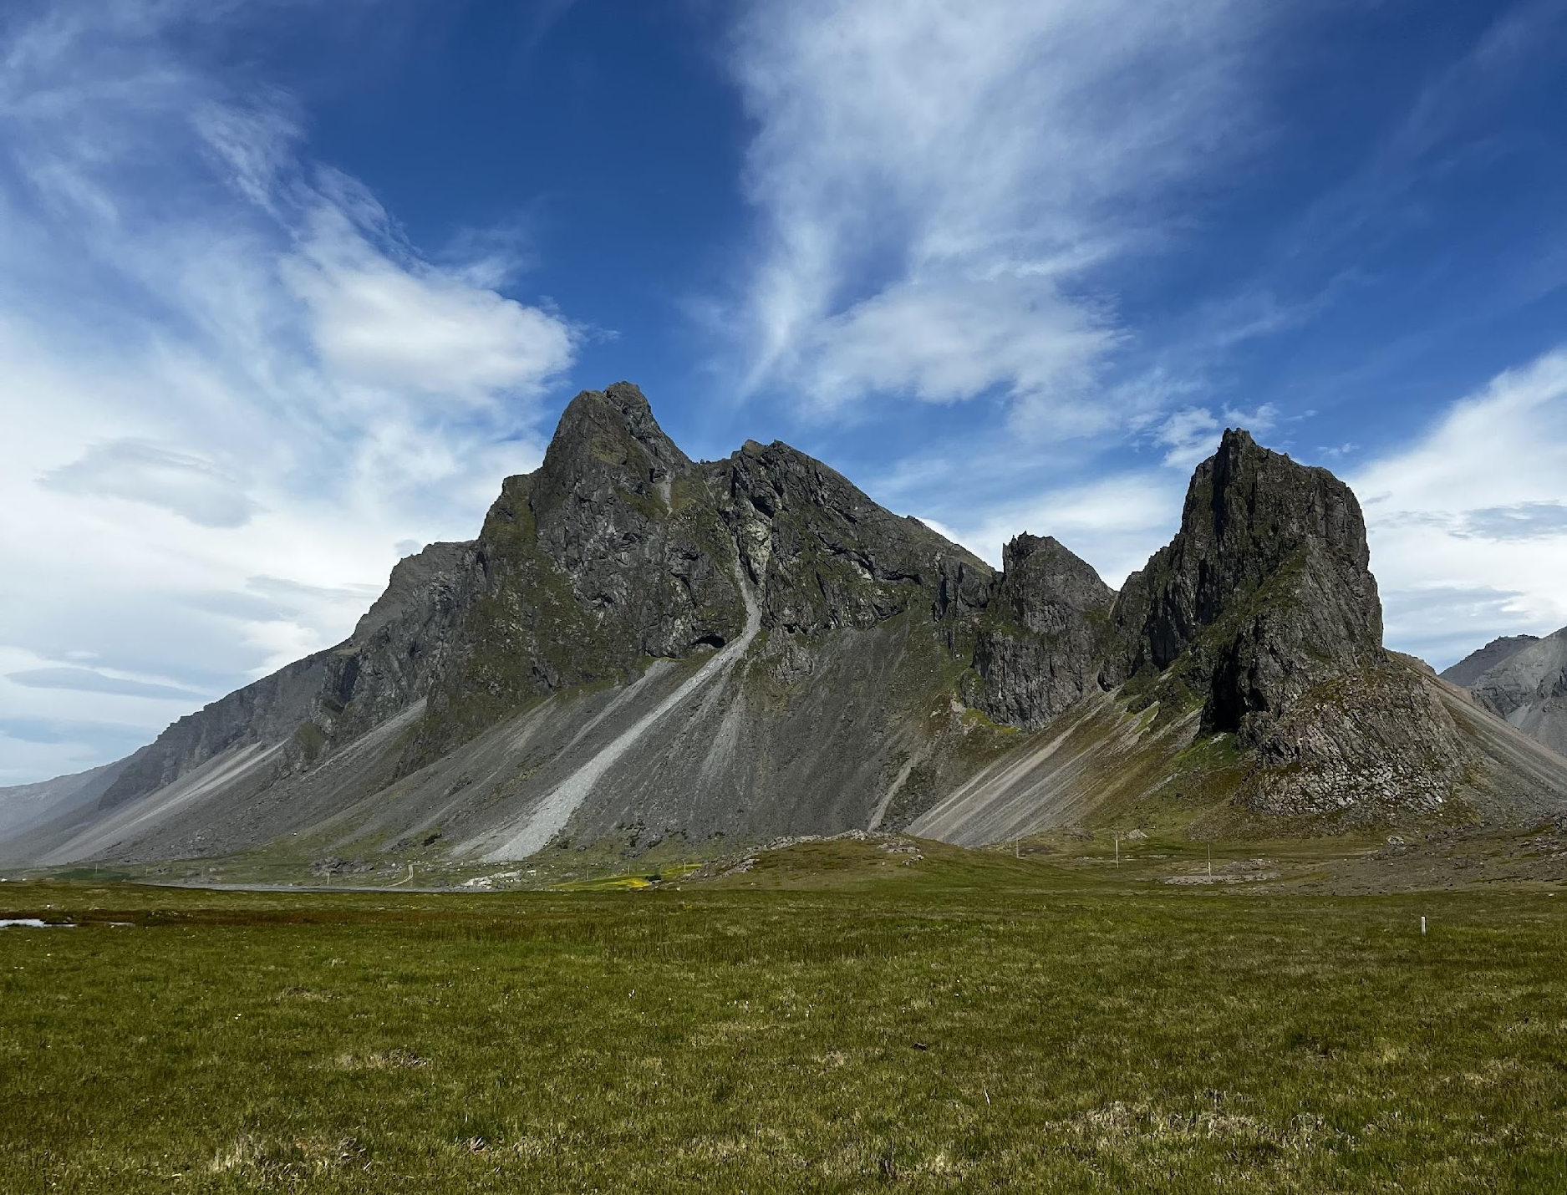
Sustainable Tourism for global good is a growing trend
Click to learn more
The four components of sustainable tourism from the Global Sustainable Tourism Council:
Effective Management: How are you implementing and managing sustainable practices across your tourism business?
Social & Economic: How are you helping the places where your tourism product operates?
Environment: How are you protecting, conserving, educating, and being a net positive steward of the environment and ecosystem in which you operate?
Cultural: How does your tourism business support cultural heritage?
TEDx - Turn tourism into a force for the global good
Notes:
GSTC:
https://www.gstcouncil.org/about/
TEDx:
Turn tourism into a force for the global good | Mikkel Aarø-Hansen | TEDxCopenhagen – YouTube
https://tedxcopenhagen.dk/talks/turn-tourism-force-global-good

Slide 10
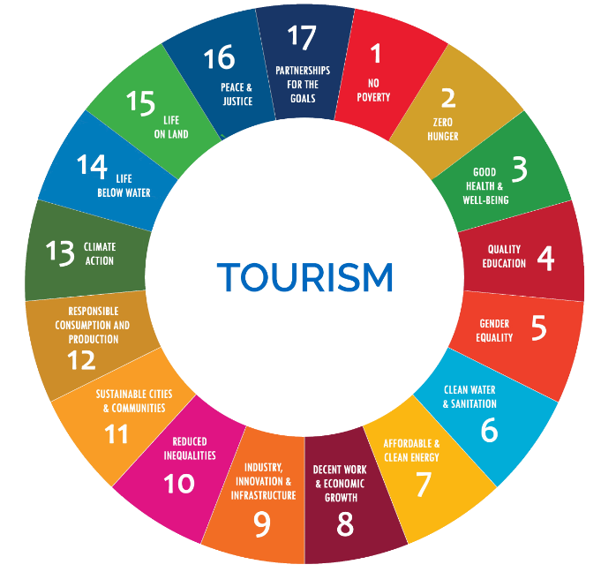
Connecting Innovative Mountain Tourism
and the SDGs
Find out what you can do? Click on the screen
Climate resilience:
“Among all this action, the challenge for the travel industry will be proving it’s not all greenwashing. Tourists, alongside investors, will hold companies to account over their progress, so there’s work being done on standards, regulations and reporting.”
Skift 2022
Notes:
SDG
Tourism for SDGs – Welcome To The Tourism For SDGs Platform! (tourism4sdgs.org)
https://tourism4sdgs.org
Skift
Skift-Megatrends-2022.pdf (hubspotusercontent40.net)
https://skift.com/megatrends-2022/

Slide 11

Want to be a Responsible Mountain Entrepreneur?
Industry Criteria - Click on the screen
Check on the GSTC Industry Criteria with performance indicators to help you build a sustainable business in the mountains.
Also, familiarise with the criteria in your own country.
Notes:
GSTC
GSTC Criteria | GSTC (gstcouncil.org)
https://www.gstcouncil.org/gstc-criteria/

Slide 12
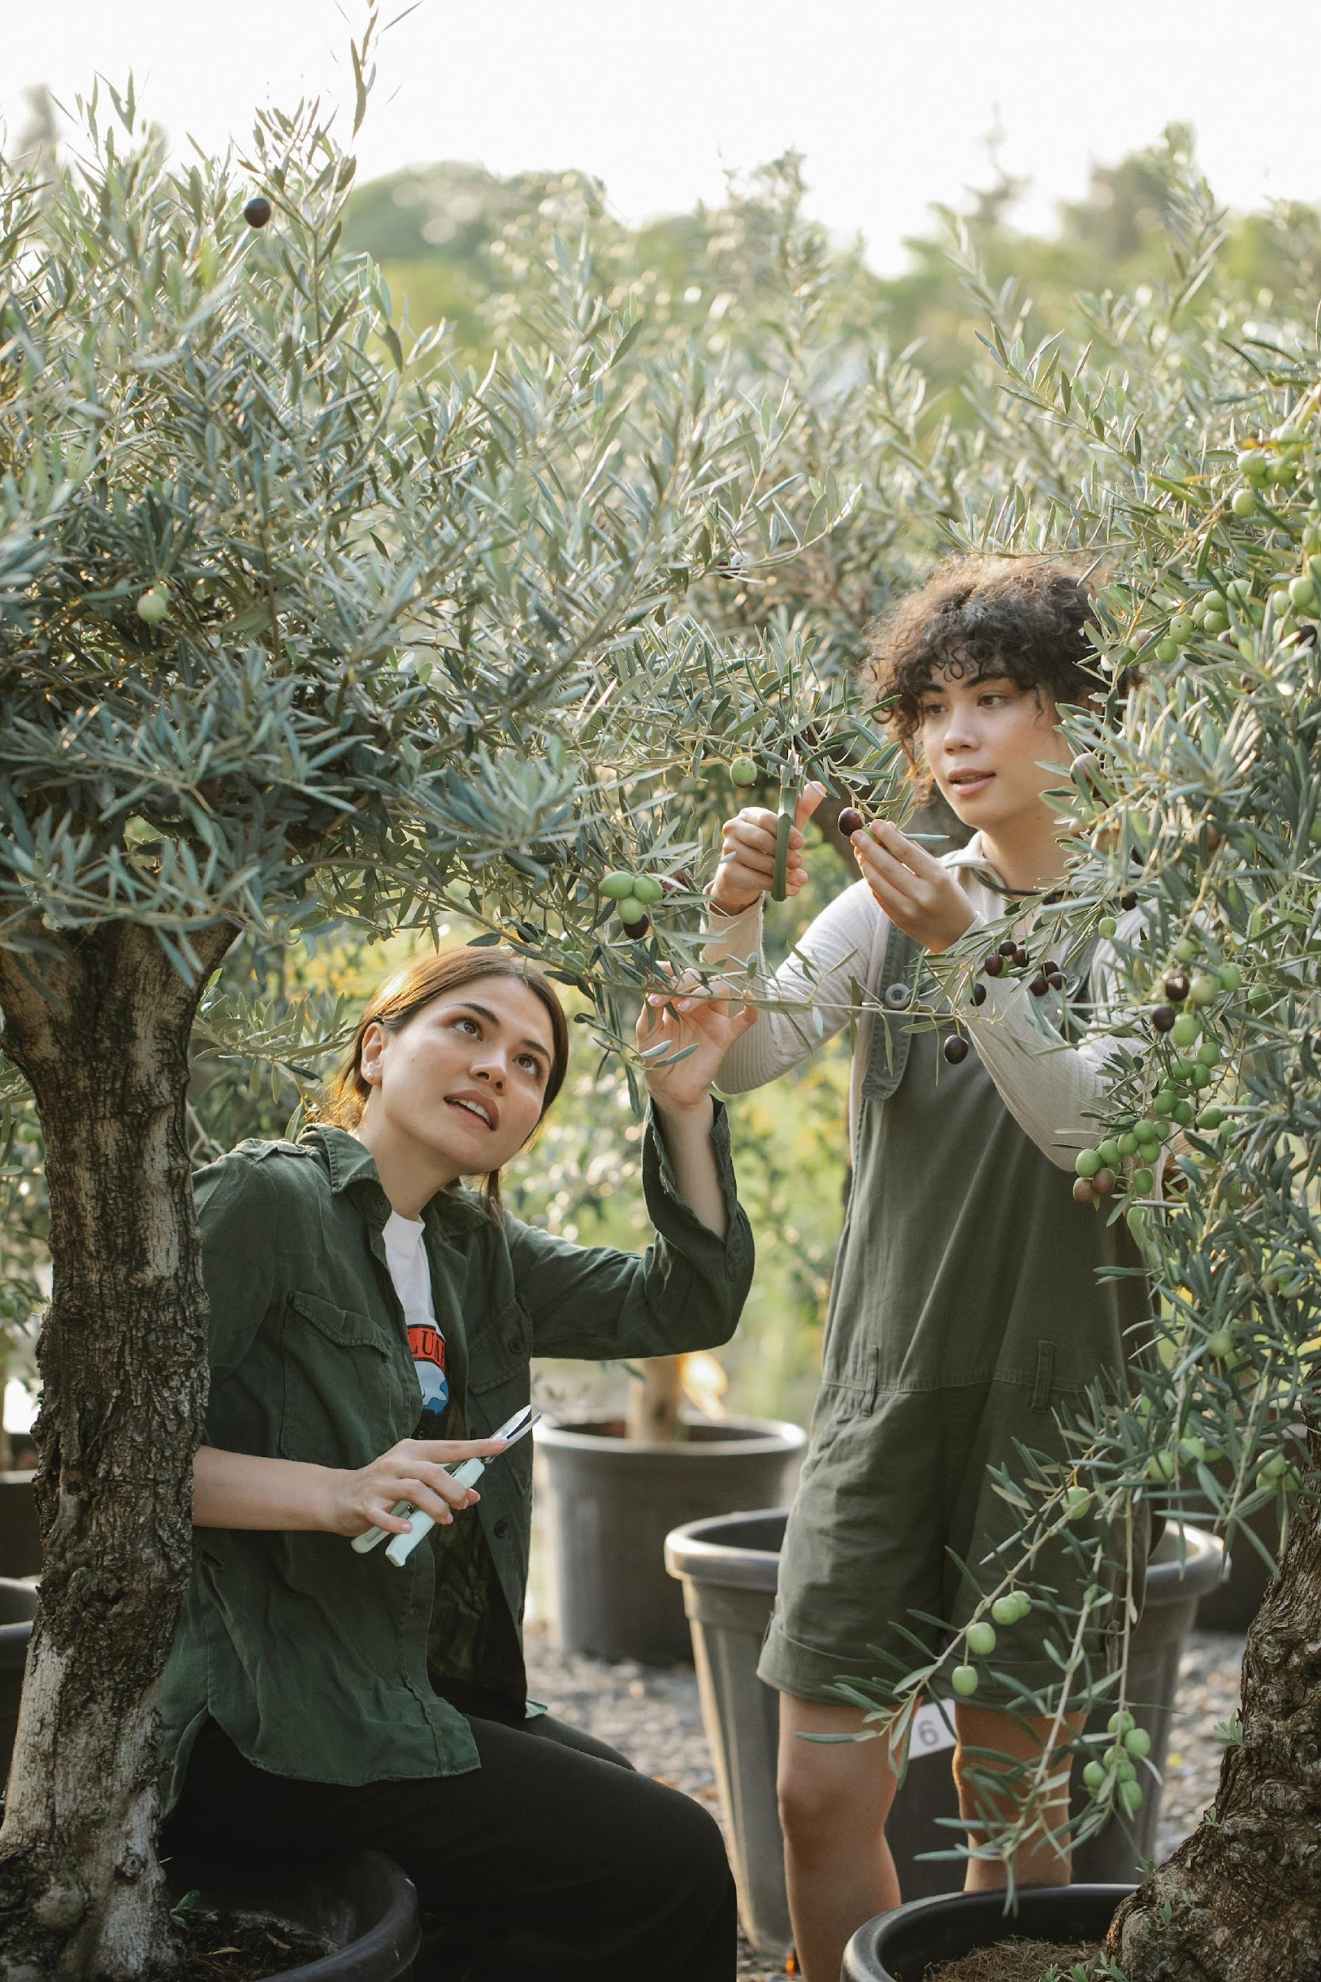
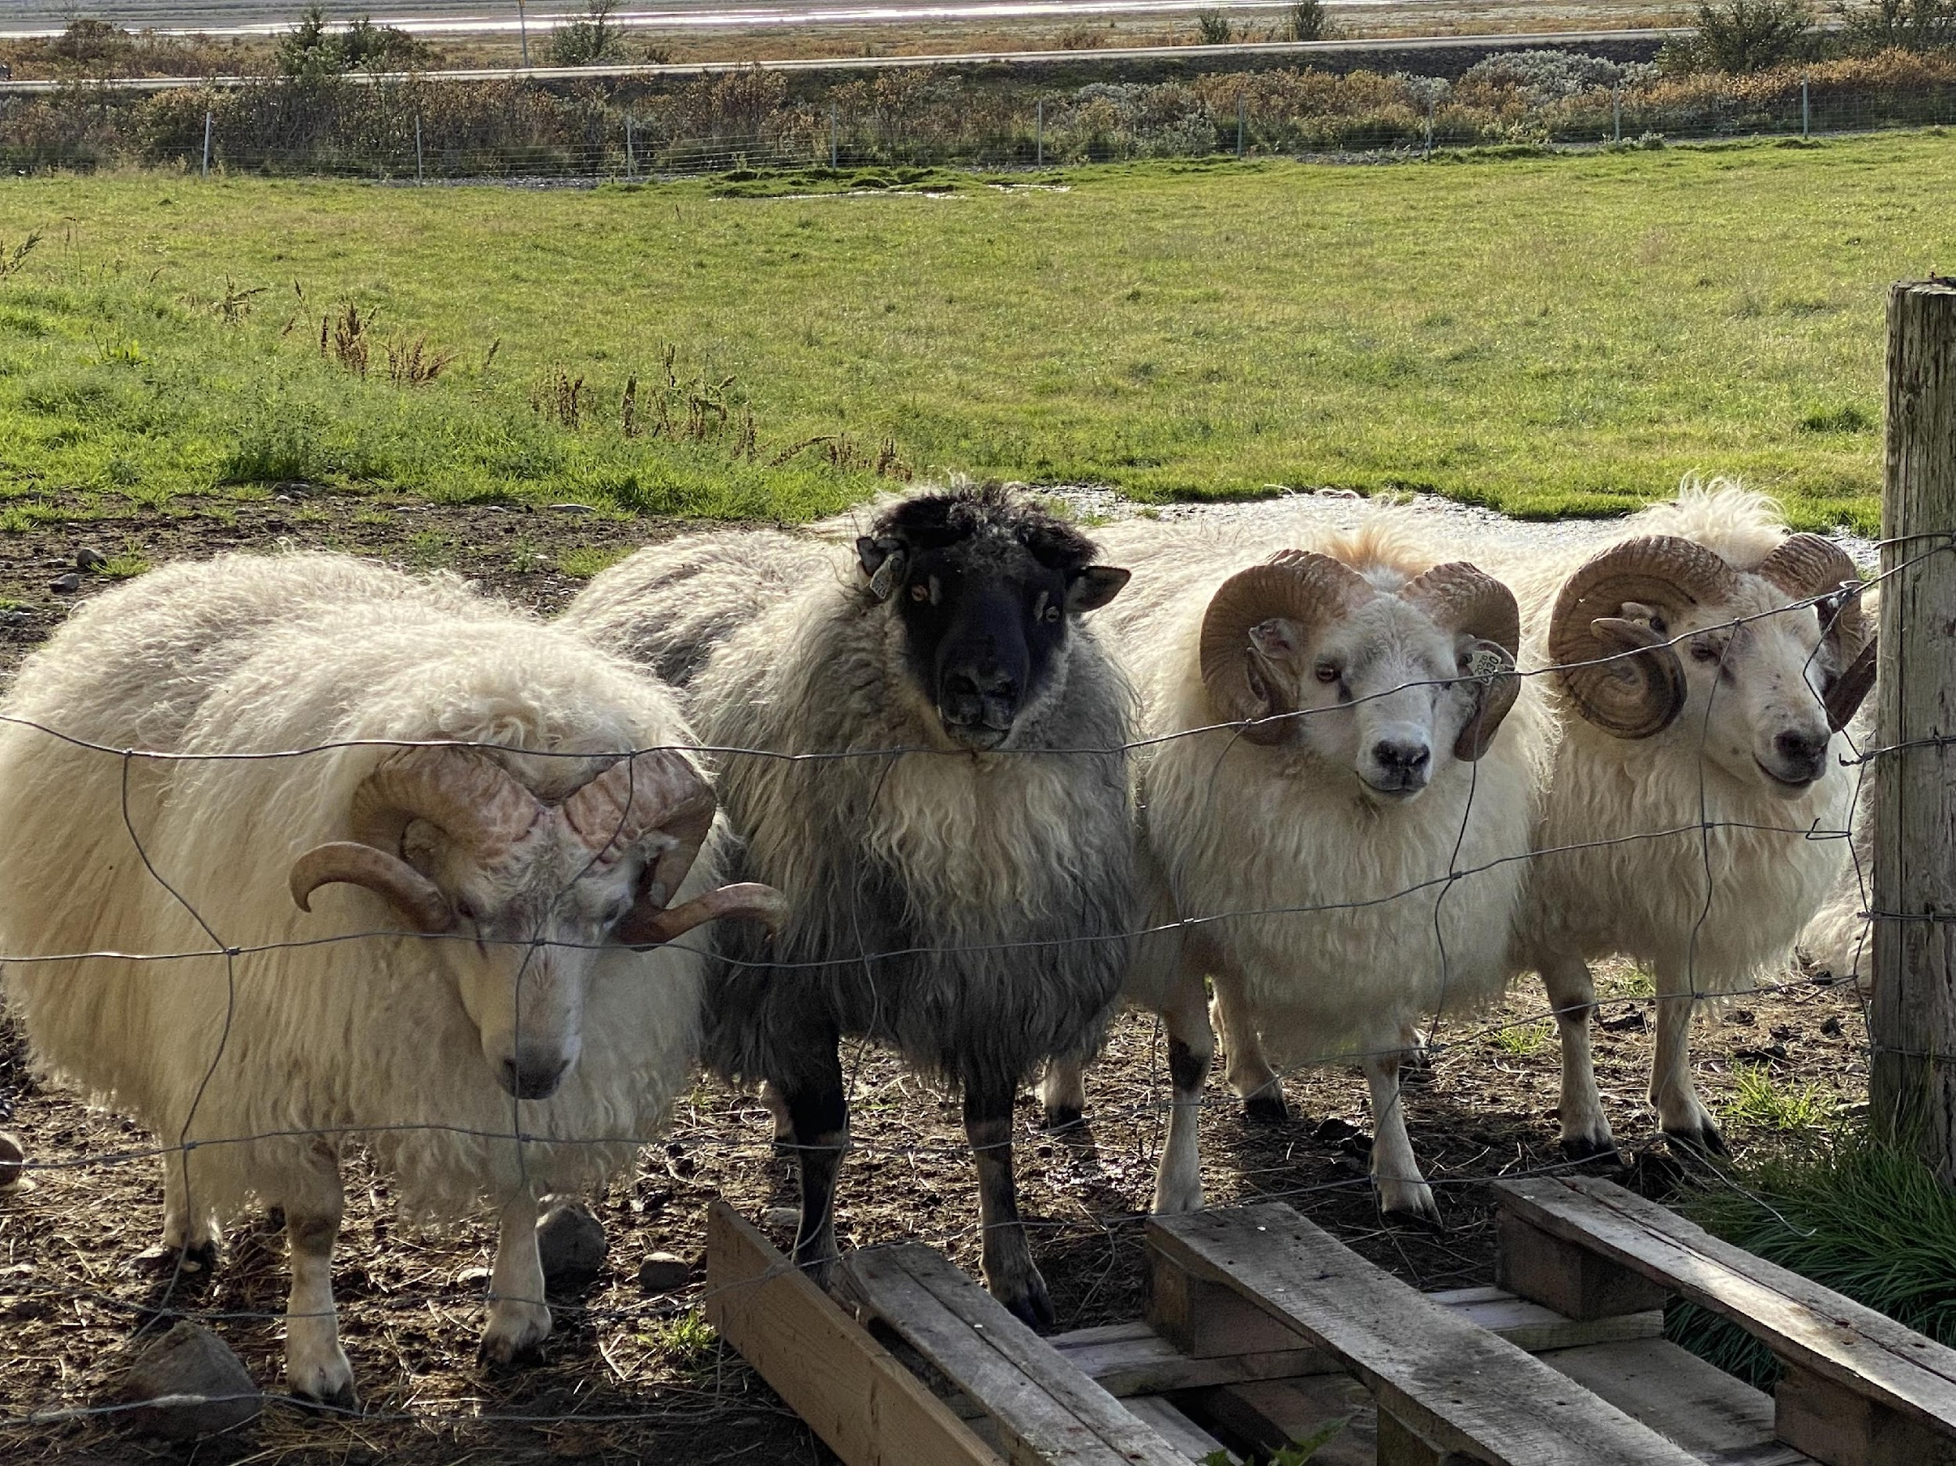
Is Agriculture or Farming your passion?
Learn about 10 new tech trends in innovative agriculture by clicking on the photo
Click!
Notes:
https://masschallenge.org/articles/agriculture-innovation/

Slide 13
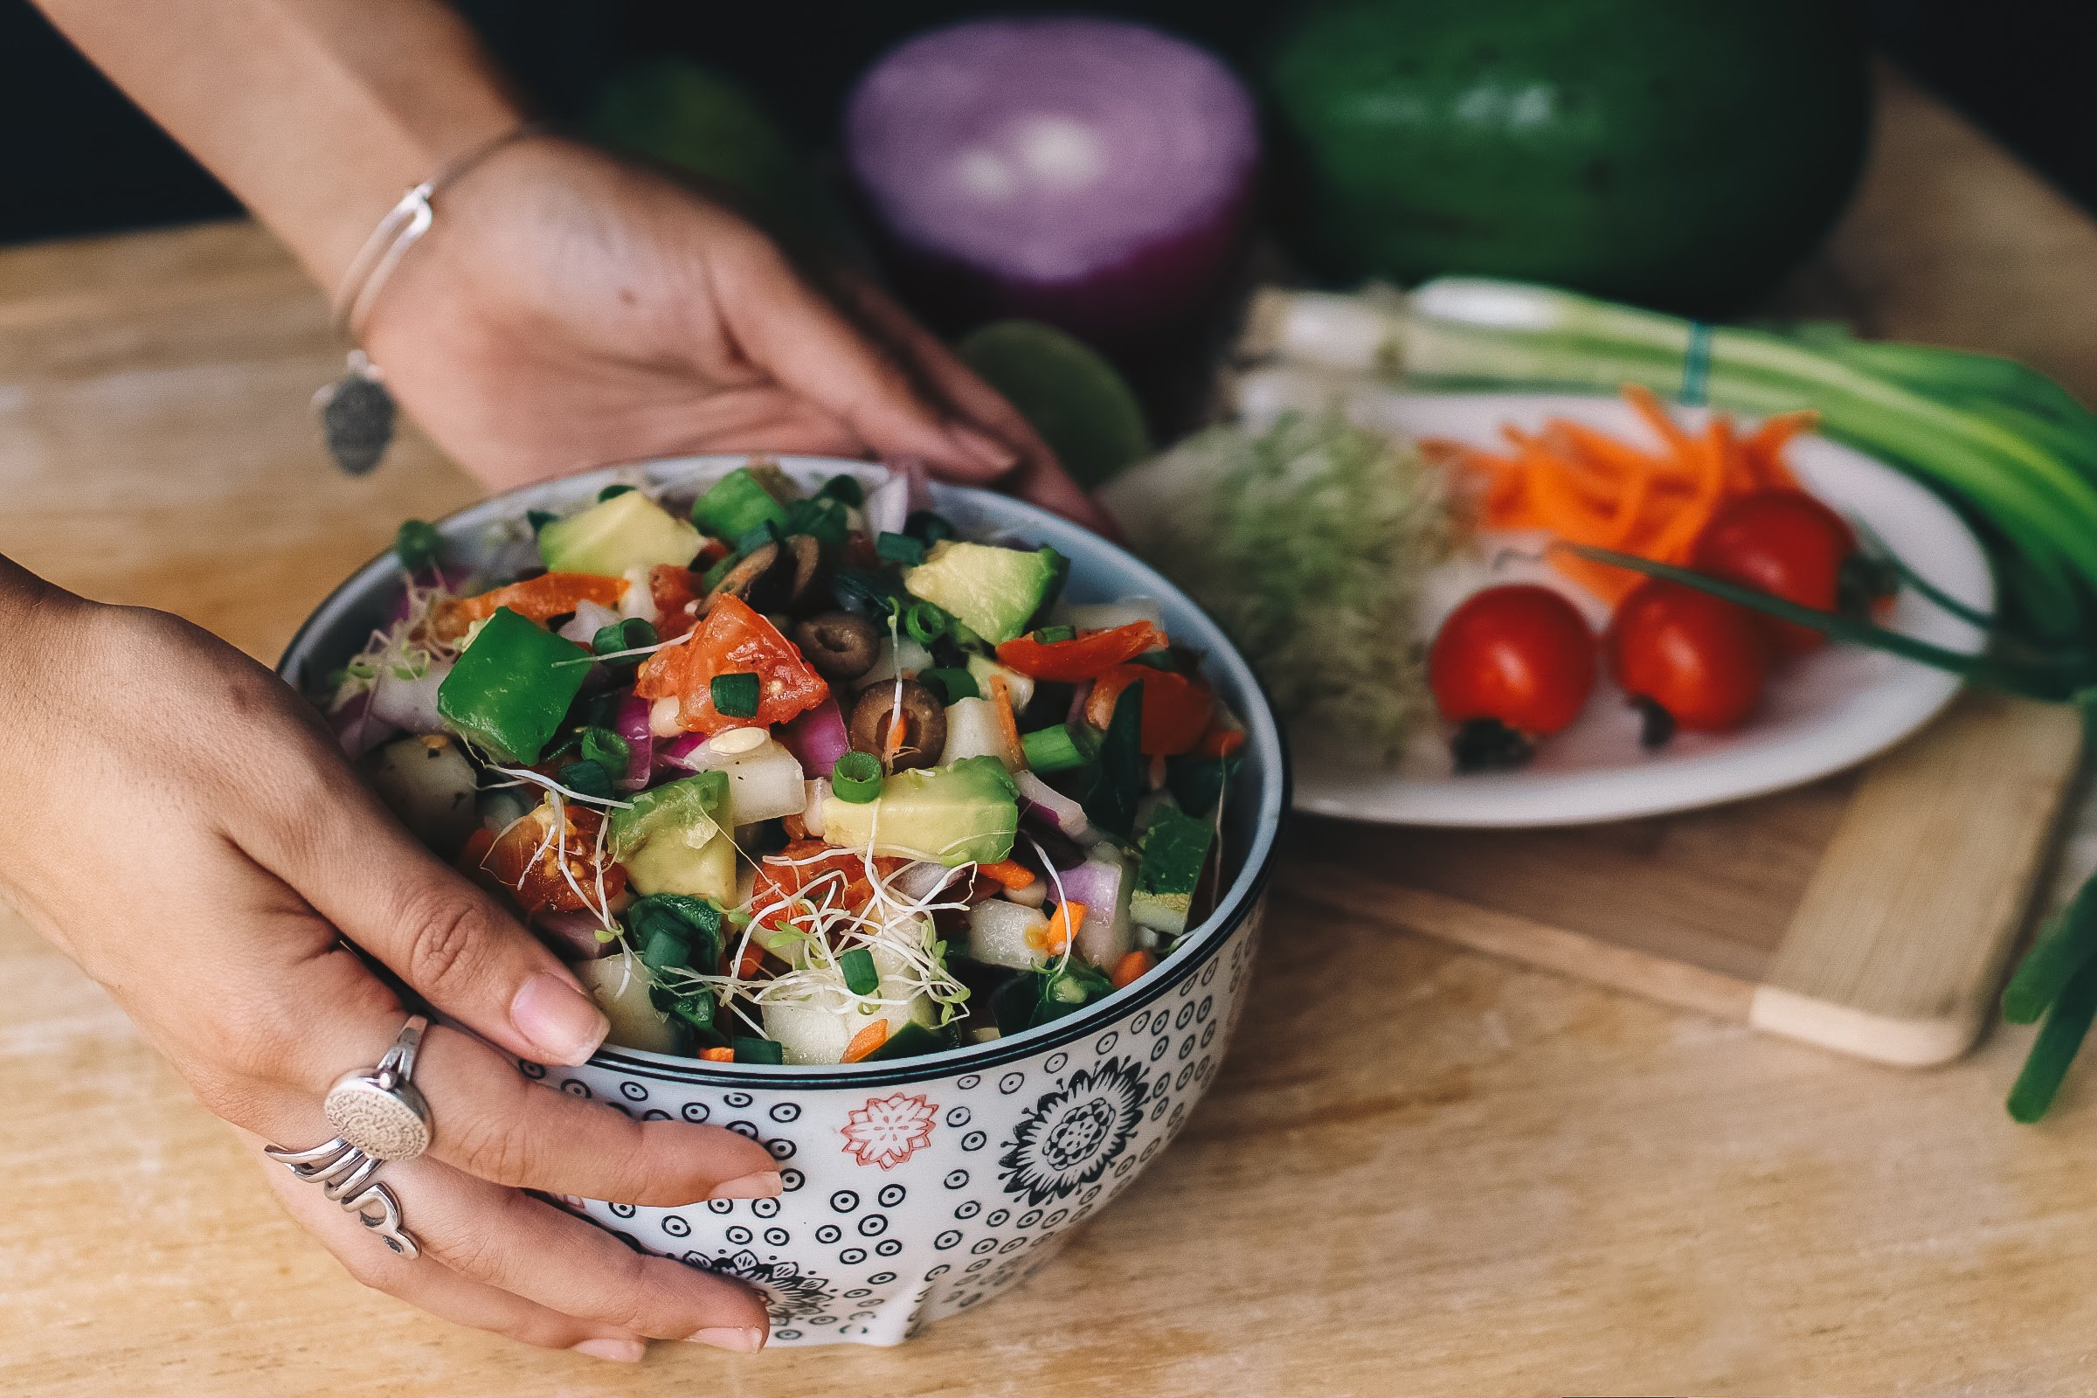
Agritourism
Do you want to combine mountain farming and tourism? Take a look at what others are doing.
An example of sustainability and agritourism, click on the screen.
Notes:
BREATHTAKING Farm Pioneering Organics in Croatia! - YouTube
https://www.youtube.com/watch?v=aRxymTETvXk

Slide 14
Want to learn more from others about agritourism?
More examples:
Kmetia-Urska
Slovenia
Vallanes Iceland
Friðheimar Iceland
Notes:
Vallanes
https://modirjord.is/en/
Kmetia-Urska:
https://firbas.com/en/
Friðheimar
https://www.fridheimar.is/en

Slide 15
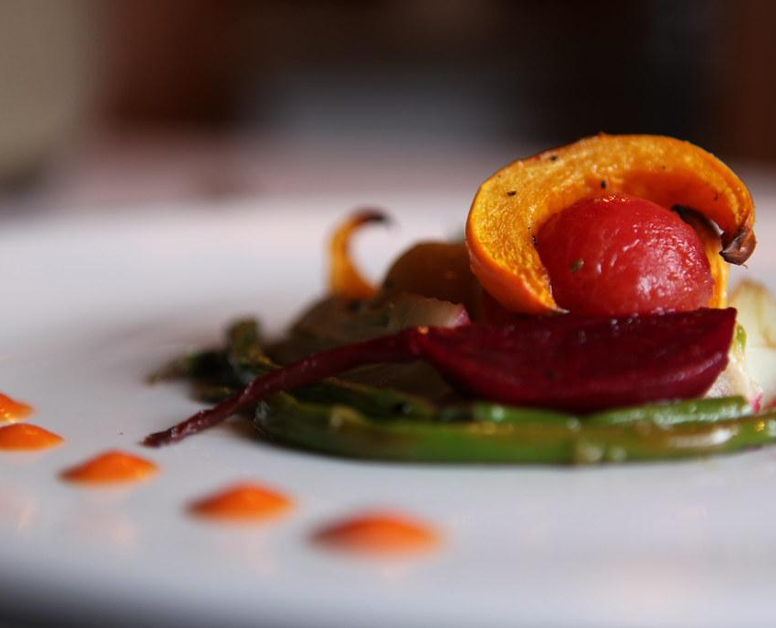
Want to take your restaurant to a new level?
Zero Waste Restaurants
Check this out!
According to FAO, approximately a third of all food produced in the world is lost or wasted every year.
Zero waste restaurants focus on reducing, reusing, and recycling their collective resources. Zero waste ideas and practices also encourage a circular economy, which is sustainable and improves profits.
Notes:
Why The Future Of Cooking Is Going To Be Zero Waste
https://www.youtube.com/watch?v=sXmBA-u3kyg

Slide 16
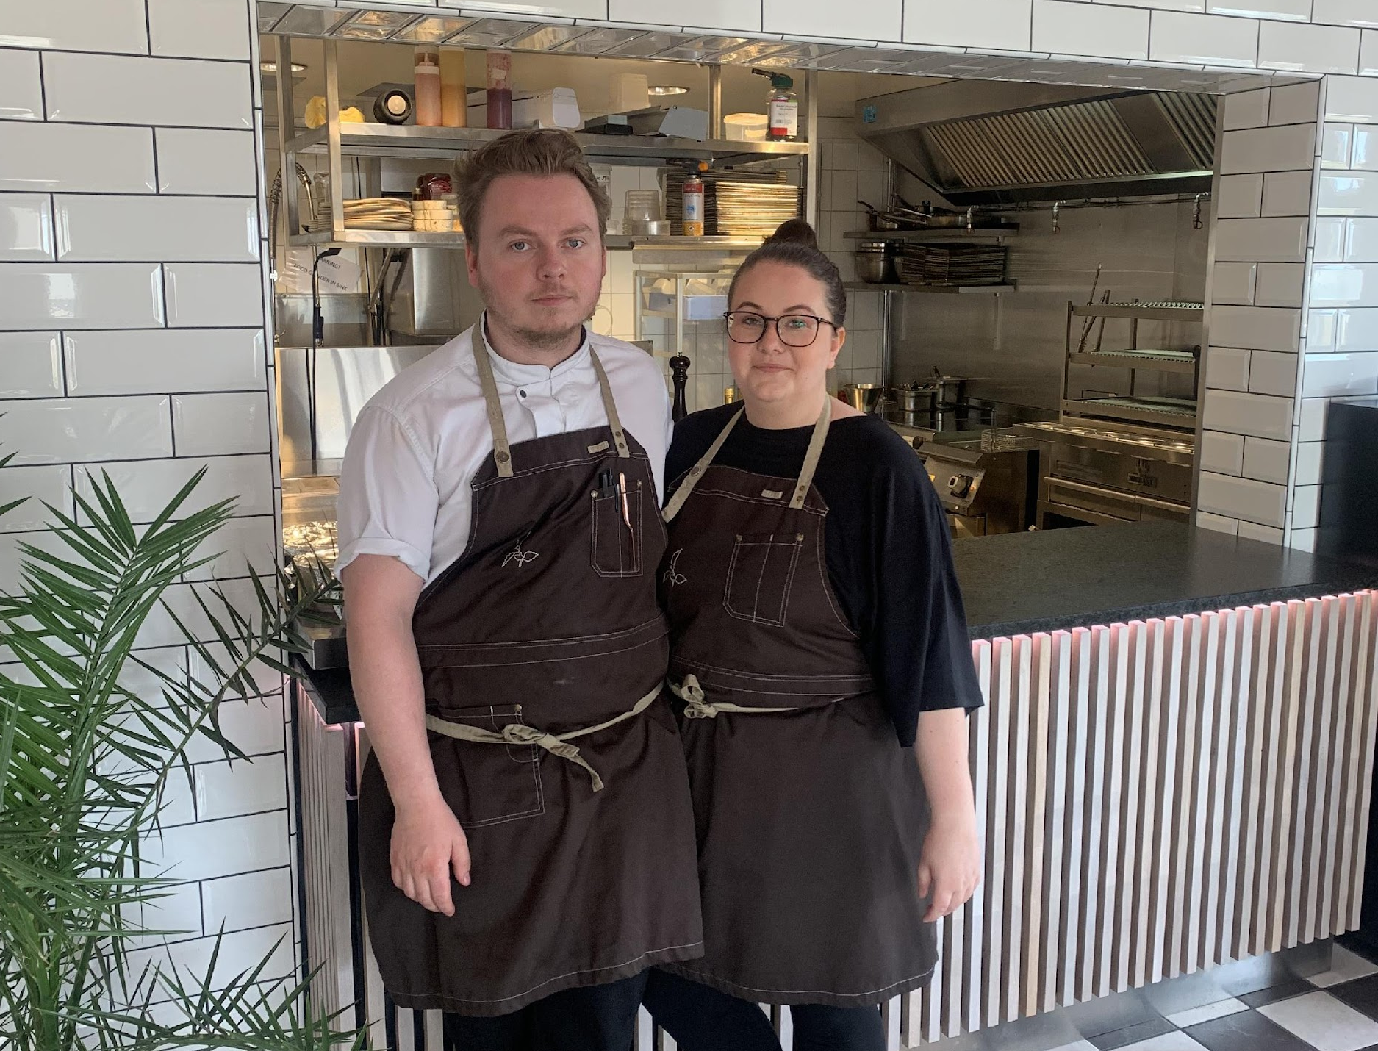
Get inspired
Peer learning is a powerful and direct tool that allows you to touch upon what you have learnt so far.
Click!
Watch videos of young entrepreneurs who have started a business in mountainous areas of the EU and get inspired!
Notes:
https://www.youtube.com/channel/UCTViMLo7TqGSW7-uhEPdDjA

Slide 17
Are you looking for an idea?
Practice using the tools introduced in module 3a to find, improve
and evaluate your idea
1. Systematic Inventive Thinking: slides 15 and 16 in module 3a
2. Design Thinking: slide 17 and 18 in module 3a
3. Evaluating ideas: slide 19 and 20 in module 3a

Slide 18
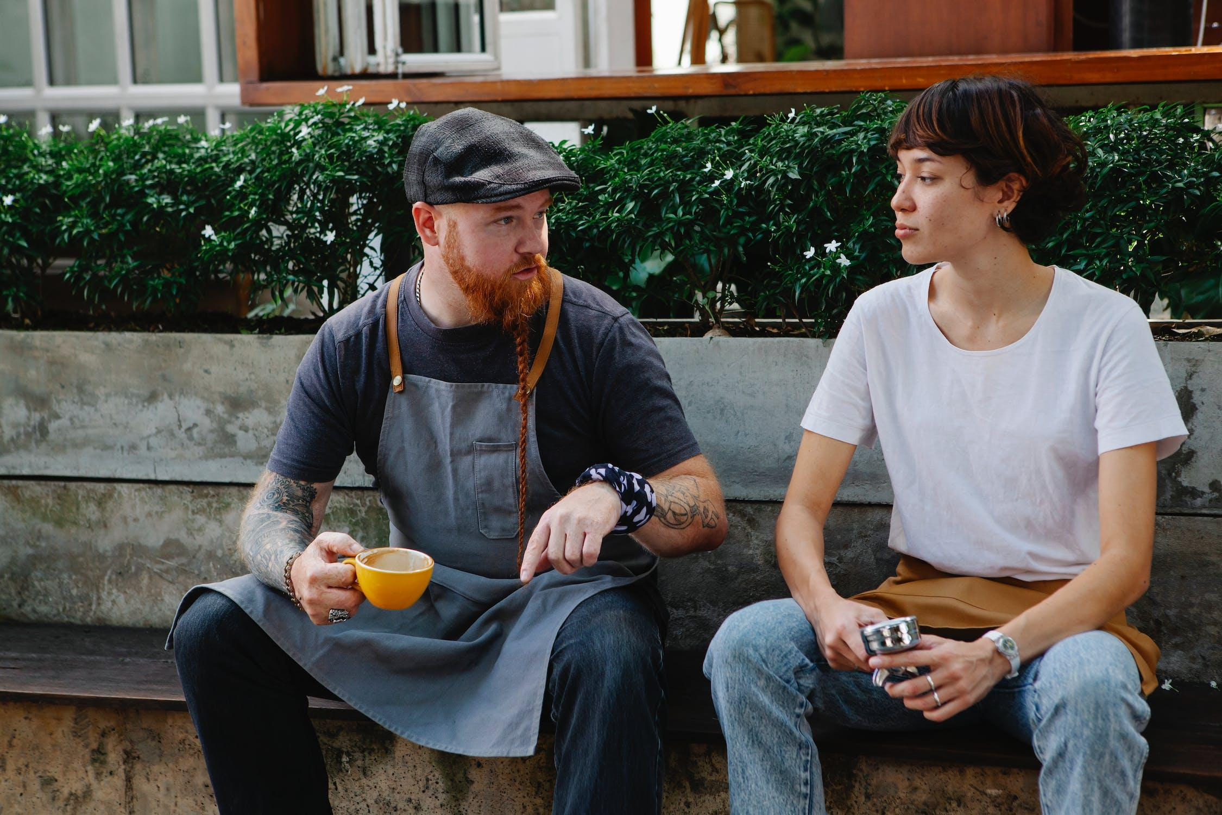
What did you learn?
Teach a friend what you learned!
Tell a friend what this module discusses
Discuss, criticise and disagree
Do the short assignment on Evaluating Ideas (slide 16 in module 3a) together
Enjoy, and good luck with your business idea ☺

Slide 19
Quiz
A
B
C
What are the three pillars of Sustainability?
What are the five stages of
Design Thinking?
What three elements do Transformative Travel Experience consist of ?

Slide 20
QUIZ: Answers to questions A – C
A
B
C
Economy
Environment
Society
Empathize
Define
Ideate
Prototype
Test
Connection
Authenticity
Personalisation

Slide 21



Links to PEAK:
Well done!
YouTube: https://www.youtube.com/@peakentrepreneurs2892/videos
TikTok: https://www.tiktok.com/@peakentrepreneurs
Instagram: https://www.instagram.com/peak.entrepreneurs/
Facebook: https://www.facebook.com/PeakEntrepreneurs
Now get ready to move onto Module 4 Environmental Sustainability Approaches for Mountainous Businesses and Communities

