Slide 1
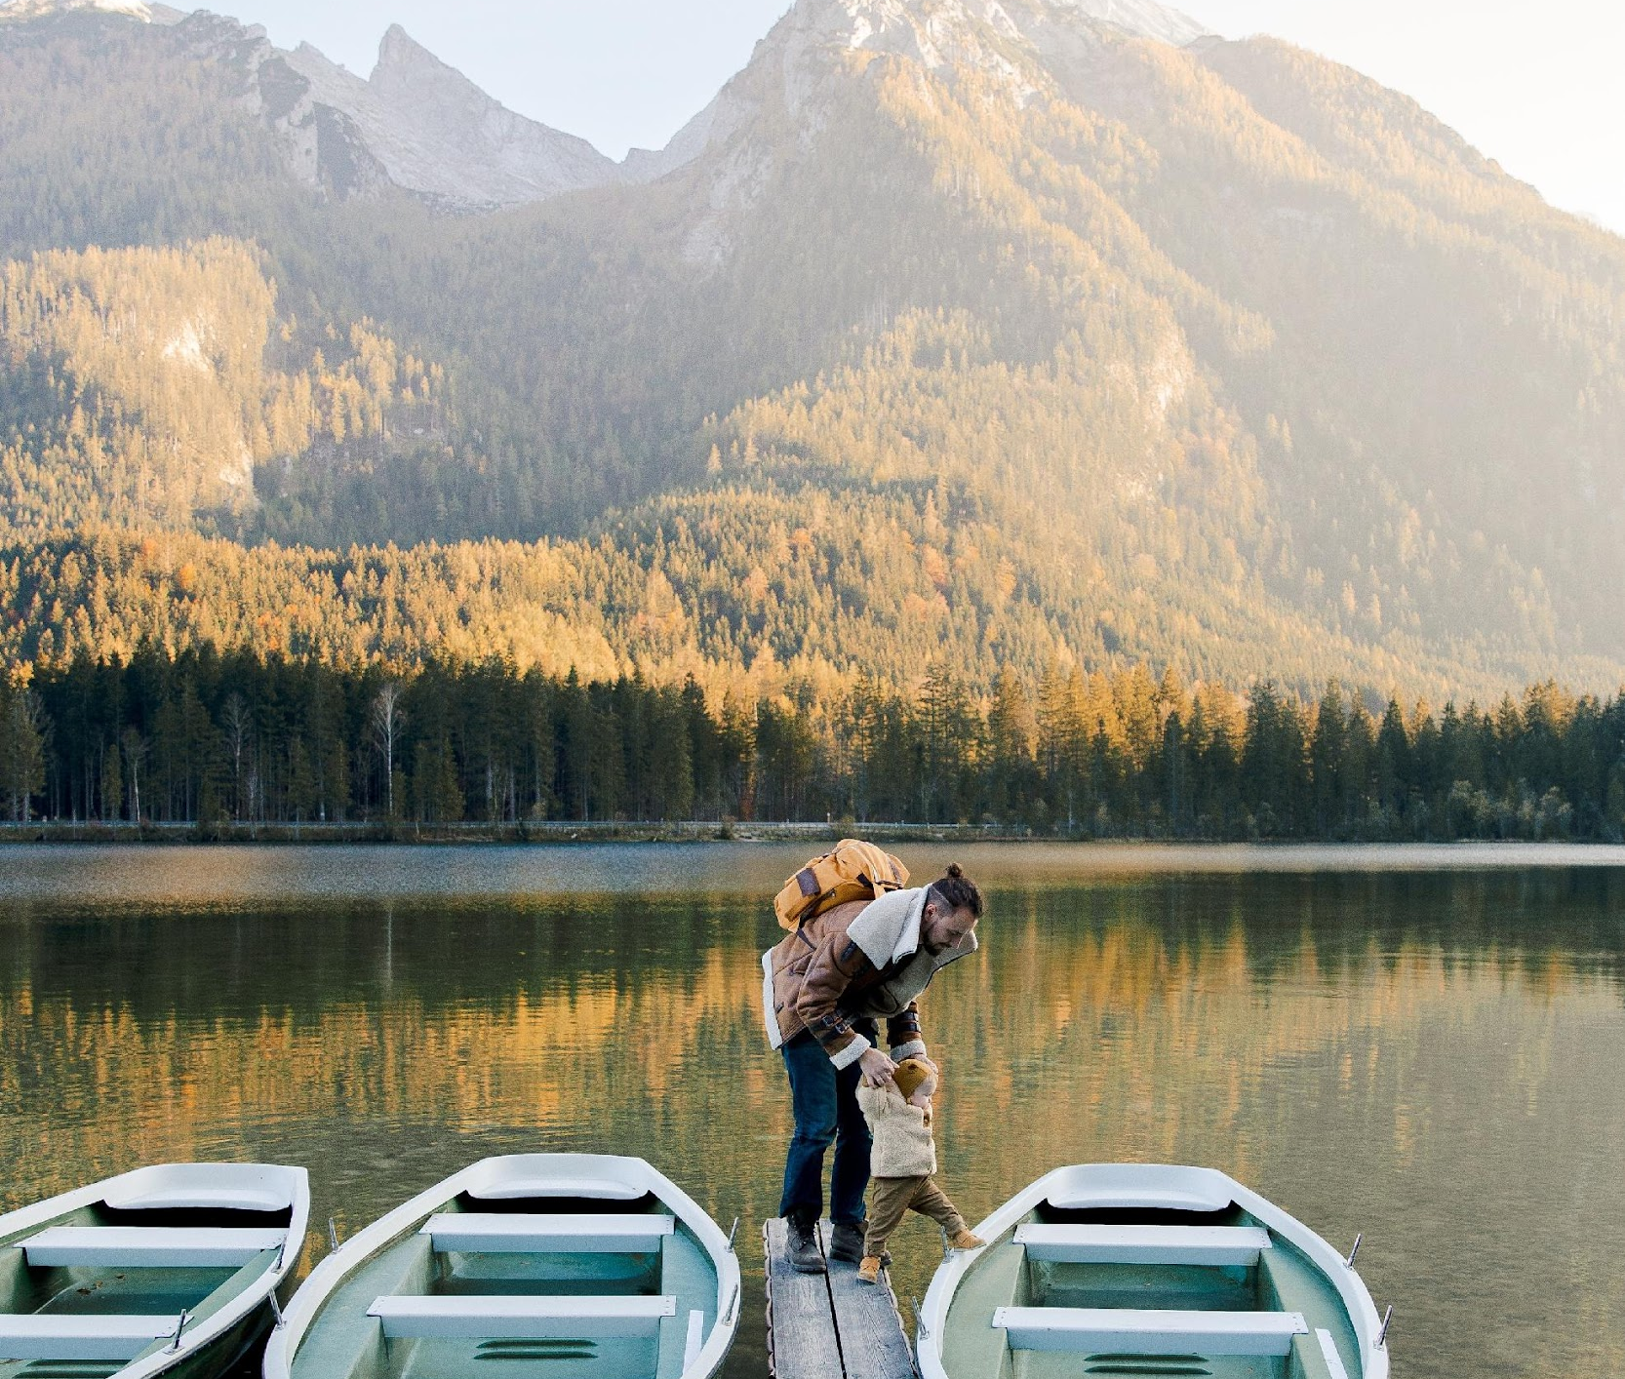
PEAK
Guida video alle migliori pratiche 2022
The European Commission support for the production of this publication does not constitute an endorsement of the contents which reflects the views only of the authors, and the Commission cannot be held responsible for any use which may be made of the information contained therein. 2020-3-UK01-KA205-094357
www.peakentrepreneurs eu

Slide 2
Indice
01
Informazioni sul progetto PEAK
02
Risultati di apprendimento della Guida
03
Piattaforma online - Canva
Imparare a creare un video su YouTube
04
Reel di Instagram e Facebook
Imparare a modificare le bobine in Canva
05
Piattaforma online - YouTube
Imparate a usare YouTube come piattaforma editoriale
www.peakentrepreneurs eu

Slide 3
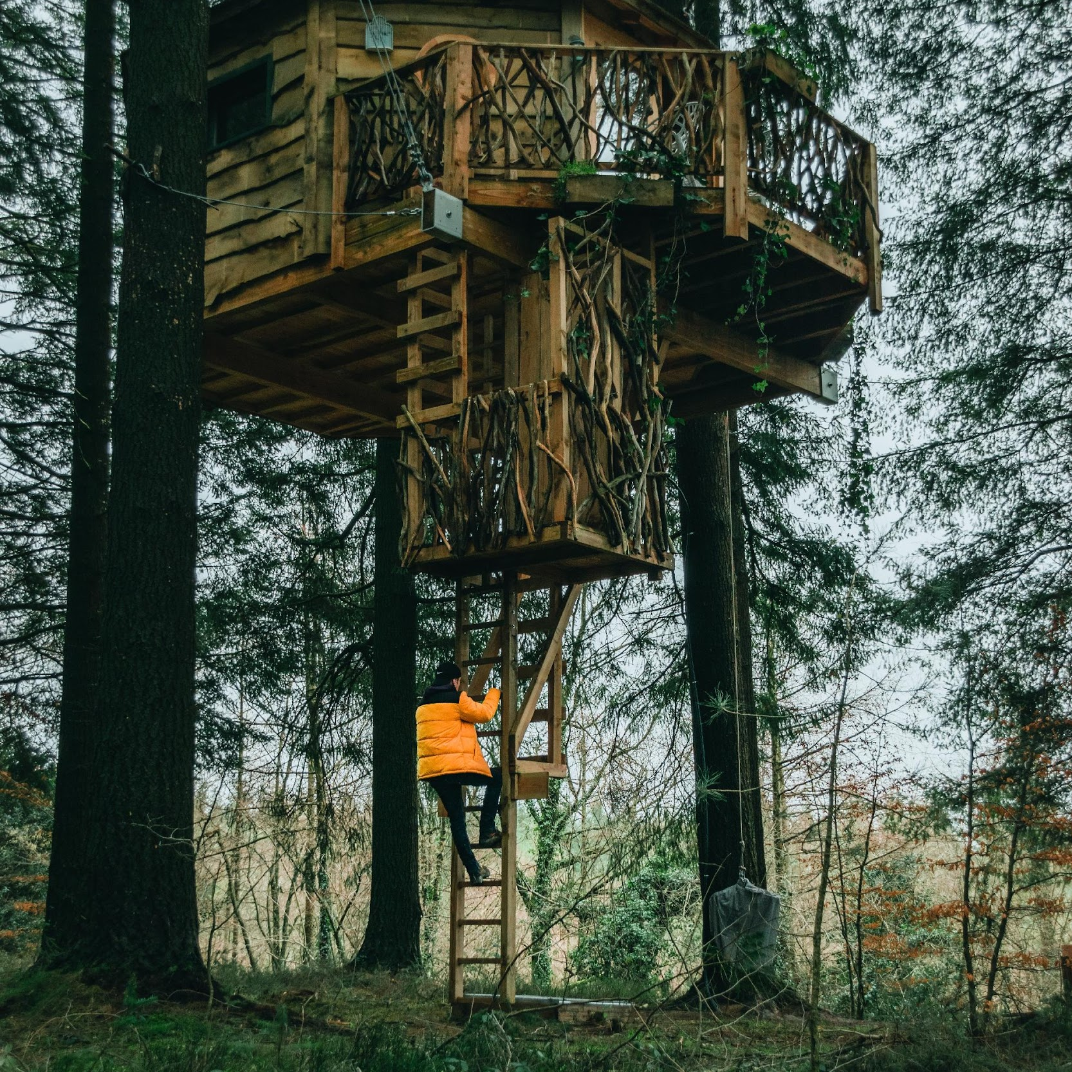
01
Progetto PEAK
L'obiettivo principale del progetto PEAK è quello di contribuire alla sostenibilità e al sostentamento dei giovani imprenditori di montagna in tutta Europa, sviluppando le competenze dei giovani imprenditori di montagna esistenti e futuri, ma anche assistendo i loro sistemi di supporto, ad esempio manager, dipendenti, studenti di formazione professionale nel settore delle imprese di montagna, attraverso una piattaforma di formazione innovativa e facilmente accessibile.
PEAK sostiene le giovani imprese europee di montagna sviluppando quanto segue;
Un curriculum e materiale didattico per educatori e formatori dell'istruzione e della formazione professionale nei settori delle imprese di montagna, rivolto a studenti, imprese e dipendenti di aziende, aree e regioni di montagna.
Una guida video sulle migliori pratiche e video sulle buone pratiche progettati per ispirare ed educare i proprietari di aziende e i dipendenti esistenti, i potenziali imprenditori e i giovani studenti di montagna.
Una Piattaforma E-Learning completo di programmi e moduli di formazione
Un'applicazione Android e IOS per aumentare l'accessibilità e la facilità d'uso della piattaforma e-learning.
Clicca qui per accedere alle risorse

Slide 4
02
Cosa imparerai
Superare i principali ostacoli dell'imprenditoria di montagna sviluppando i propri media digitali
Eliminare la confusione e la sensazione di essere sopraffatti dalle informazioni dei media digitali. Questa guida vi aiuterà a raggiungere le pepite d'oro, i vantaggi chiave e le strategie più efficaci, in modo da non sentirvi sovraccaricati di informazioni. Vi presenta consigli e informazioni mirati e personalizzati per poter navigare nei media digitali e sociali specifici per le imprese turistiche.
Acquisizione di conoscenze e formazione pratica sui media digitali delle imprese di montagna.Capire come sviluppare media digitali in modo efficiente in termini di costi e di tempo attraverso istruzioni pratiche passo-passo e tutorial per tutti i livelli.
Guadagnare dai costi e ottenere un ritorno sui benefici. Adattate i vostri media digitali in modo da distinguervi dalla massa, far crescere il vostro pubblico, costruire il vostro marchio e formare una forte comunità online.
Imparate a identificare e utilizzare le opportunità offerte dai media digitali. Questa guida ha selezionato le principali piattaforme e strumenti per i media digitali, in modo che possiate concentrarvi maggiormente su ciò che funziona per la vostra attività turistica.
Acquisire conoscenze tecniche sufficienti e accedere a piattaforme gratuite e di facile utilizzo.
Increase Your Access to Expertise.
You or Your Staff become the Experts.
Pronti per il digitale
Impegnatevi, preparatevi, conoscete e confidate nella creazione dei vostri video tramite YouTube, Canva, Instagram e Facebook.

Slide 5
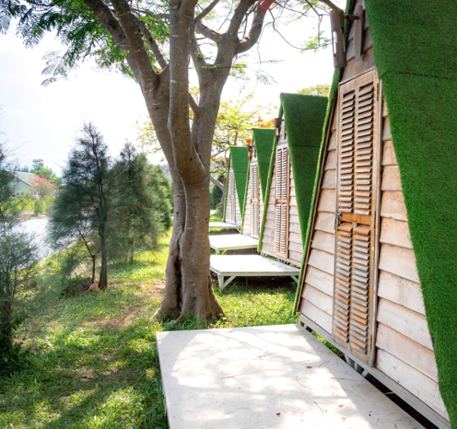
Learn Good Practice From Other European Youth Mountain SMEs
Throughout the Video Showcase Book, we will provide good practices for young mountain enterprises examples across Europe. In the context of this document, a good practice SME will include the below criteria
Be fundamentally a young mountain enterprise as its key objective, purpose, focus, and or business activity
Their approach is practical, simple, affordable, and feasible, resources are available and easy to follow.
They are already proving a positive impact at an SME level and often spin onto stakeholders, communities, suppliers, and others
Sustainability is important and achieved socially, environmentally, and economically with long-term impact on the wider community and target groups
Their activities can be transferred, replicated, implemented, and upscaled to other similar businesses in the same or a similar geographical or thematic space.

Slide 6
Why Videos and Digital Media are Important for PEAK Enterprises
Having a YouTube channel is the best way to promote mountain enterprises because it's easy and effective. This is done by creating a video that shares some of the best experiences in your area and what is special about your business. It doesn't have to be about the history of the economy of your town; it can just show fun things to do and places to visit. Consider the five vital components of a mountain destination or your business. For example, if it is a tourism business focus on your regional Attractions, Accessibility, Accommodation, Amenities, and Activities.
Great Tip
Instantly recognizable. Ensure you improve and enhance your online presence and competitiveness. Ensure You get in front of your target audiences so that are aware of, understand, and can access your unique experiences.
Improve Growth, Build Brand and reputation. Improve, engage, and grow your customer following, support, and influencers
Overcome business challenges e.g., address seasonality, improve accessibility to product and experience, increase sales and profits via sharing and market penetration
Gain immediate attention and interest. Is comparable and can enhance or initiate ideas, further discussion, activities or is modified or considered in some way
Become visually appealing and available in different mediums e.g., descriptive information, text, awards, leaflets, videos, images, published web pages…
Get connected either through social media, website inquiries, increased followers, consistent regular sharing, watching and learning from others, accessing practical free resources
Be accessible to the public, in different formats and languages, with relevant information at the right level and pitch

Slide 7


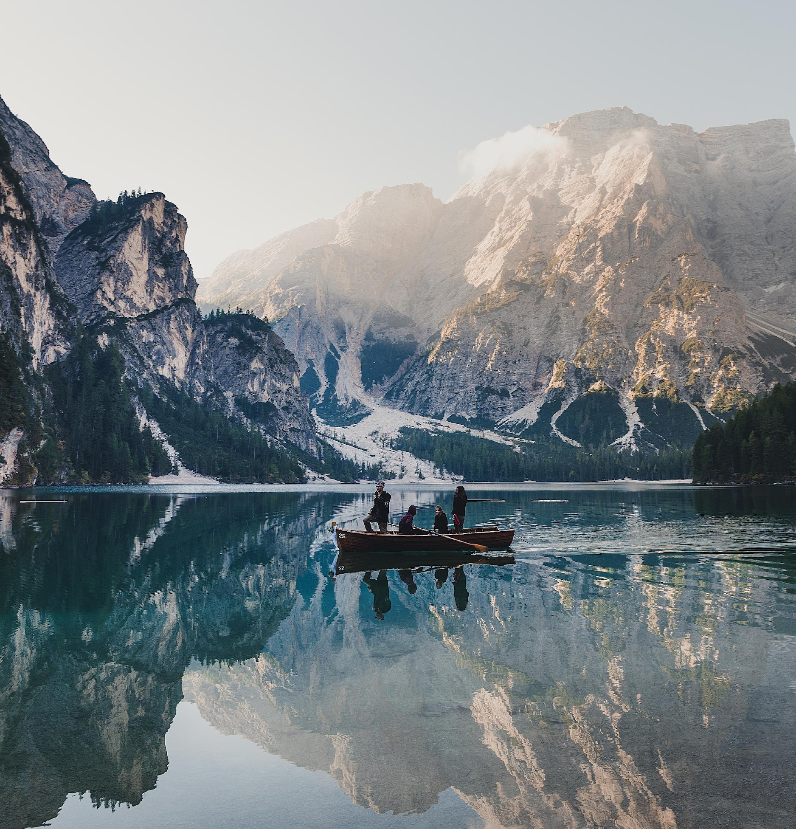
03
Canva
For Mountain Entrepreneurs
www.canva.com/

Slide 8
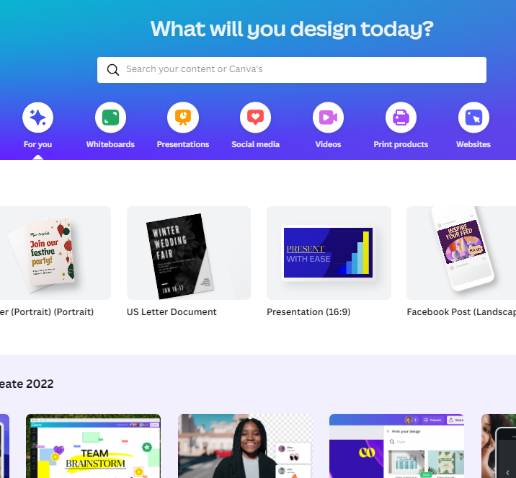

What is Canva?
Canva is a Graphic Design Tool
Canva is one of the most popular design tools that help users easily create multiple different types and styles of visual and communication media and collateral. Canva is a high-level user-friendly graphic design tool that has also gained immense popularity among professionals and amateur designers. Its simple interface and wide range of features make it an ideal platform for creating visuals for online and offline use.
However, like any other software tool, Canva has its pros and cons, which are covered in this article and should be weighed before deciding whether or not to use it. Click on any of the links in the following section to further explore the pros and cons of Canva
CLICK
TO VIEW

Slide 9
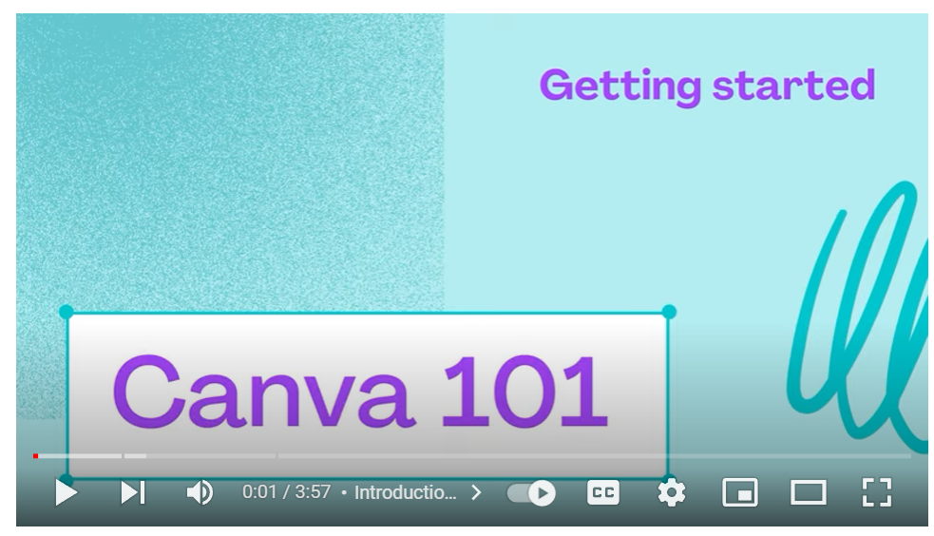

CLICK TO VIEW
Subscribe to Canva Tutorials on YouTube
https://www.youtube.com/@canva
In conclusion, Canva is a Winning Design Tool
It is evident that Canva is a powerful and user-friendly design tool that can help you create high-quality visuals for your content. Regardless of its disadvantages (like any tool), it is arguably the best design tool for anyone to become a designer without a degree. It is hard not to be satisfied with the high-quality outcome it allows you to create. Once you get started you can create stunning designs in no time. In addition to that, it offers a wide range of templates that are the right size and include all the design elements you'll need.
Click on Canva for Learners Video above
https://www.youtube.com/watch?v=V9LtRF6EbyY

Slide 10

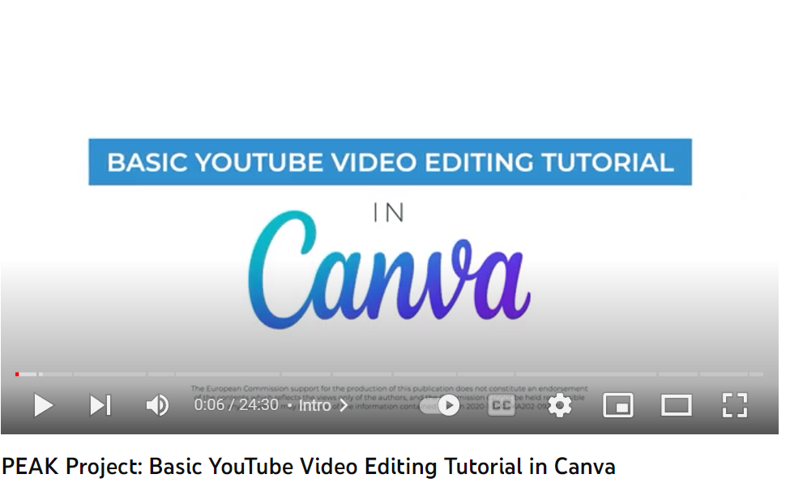
CLICK
TO VIEW
Basic YouTube Video Editing Tutorial
This video tutorial explains basic YouTube editing using the tool Canva (https://www.canva.com)
00:00 – Intro
00:42 - Working in Canva
01:50 - Creating the intro screen
04:15 - Uploading footage
05:08 - Working with the timeline
08:39 - Adding transitions
10:18 - Adding photos
12:18 - Adding music
14:25 - Working with text
16:18 - Adding an ending screen
21:04 - Adding a watermark logo
22:25 - Exporting the video file
24:02 - Ending
To learn more about working with YouTube's Free Music Gallery, please watch this video: https://youtu.be/3tA-bilniao

Slide 11
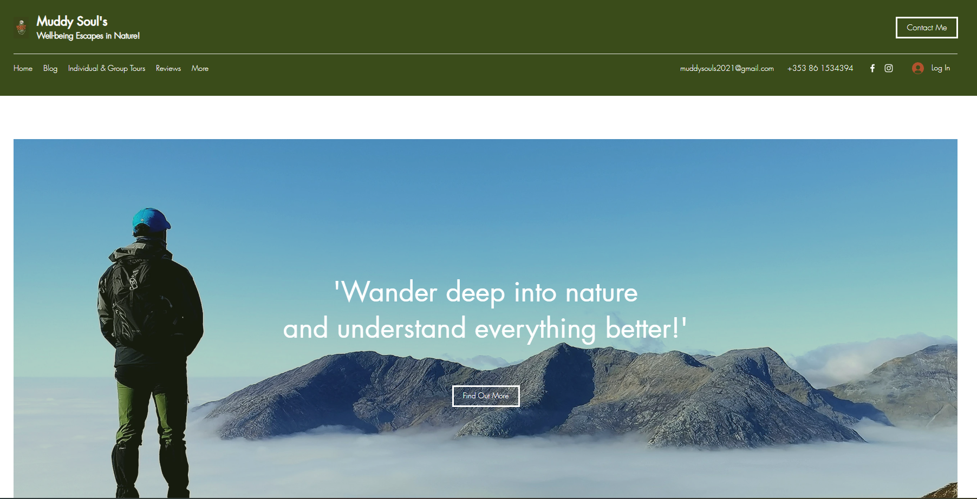
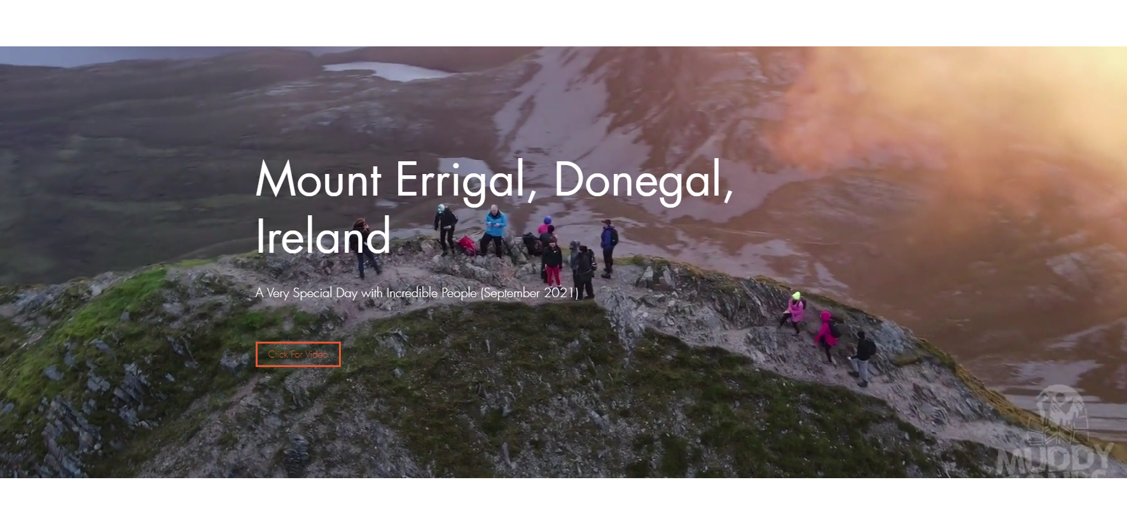
Muddy Souls Website https://www.muddysoulsadventures.com/
Example How Muddy Souls Embedded their Video in their Website and it Plays Automatically https://youtu.be/hYl54ARuyw8

Slide 12



04
Instagram &
Facebook Reels
For Young Mountain Entrepreneurs
Facebook Reels
Instagram Reels

Slide 13
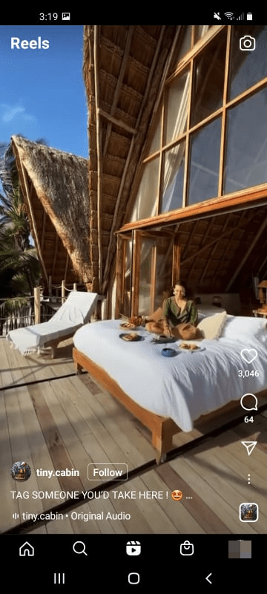
Facebook Reels vs. Instagram Reels. Which Option is Best for Your Business
Social media should already be an essential part of your marketing strategy. Social media reels can be compelling for several reasons. Firstly, you can connect with customers using a more casual and personal storytelling medium. A short video where you speak directly to your users can have a more significant impact than a regular text-based status update. Moreover, stories can foster a sense of community between your business and your customers.
Furthermore, you can use Reels to craft messages or campaigns in chronological order. They work in contrast to posts, which can get pushed out of sequence in the Facebook and Instagram feeds.
Facebook Reels are video clips that appear on people's Feeds whether or not they follow you. This expands your reach beyond friends and family and allows you to connect with new people
Instagram Reels are also video clips. You can find them by tapping the video player icon in the bottom middle section of the Instagram app.
We encourage you to incorporate Facebook and/or Instagram Reels as part of your overall content strategy. It's important to think about a mix of going live e.g., creating a video on demand, promoting your next campaign, showing your new experience or business extension, or new product. Tell people about the great things you are doing e.g., protecting the environment, making your business accessible, or working with your community. Introduce and talk about your amazing staff and get your previous customers to post video testimonials the possibilities for generating amazing content are endless. This will allow you to connect with your community wherever they are

Slide 14

Instagram Reels
Instagram Reels are a gold mine for helping you grow your following. The short, entertaining videos have a special way of grabbing users’ attention, which can mean lots of engagement for your brand, spreading the word about your products, services, and experiences, and gaining new followers. Instagram Reels are full-screen vertical videos that can be up to 90 seconds long. They come with many unique editing tools and an extensive library of audio tracks (featuring everything from trending songs to snippets of other users’ viral content). On top of sounds, Reels can include multiple video clips, filters, captions, interactive backgrounds, stickers, and more.
Why are Reels better than Stories for business? Reels are different from Instagram Stories. Unlike Stories, they don’t disappear after 24 hours. Once you post a Reel, it’s available on Instagram until you delete it. The best part? Reels are currently favoured by the Instagram algorithm, which is more likely to recommend them to people who don’t follow you than feed posts. That’s huge for mountain businesses. Users can also discover Reels in a dedicated section of the Instagram app. A scrollable feed full of trending Reels that can be accessed through the Reels icon at the bottom of the Instagram app’s home page.
https://www.facebook.com/

Slide 15
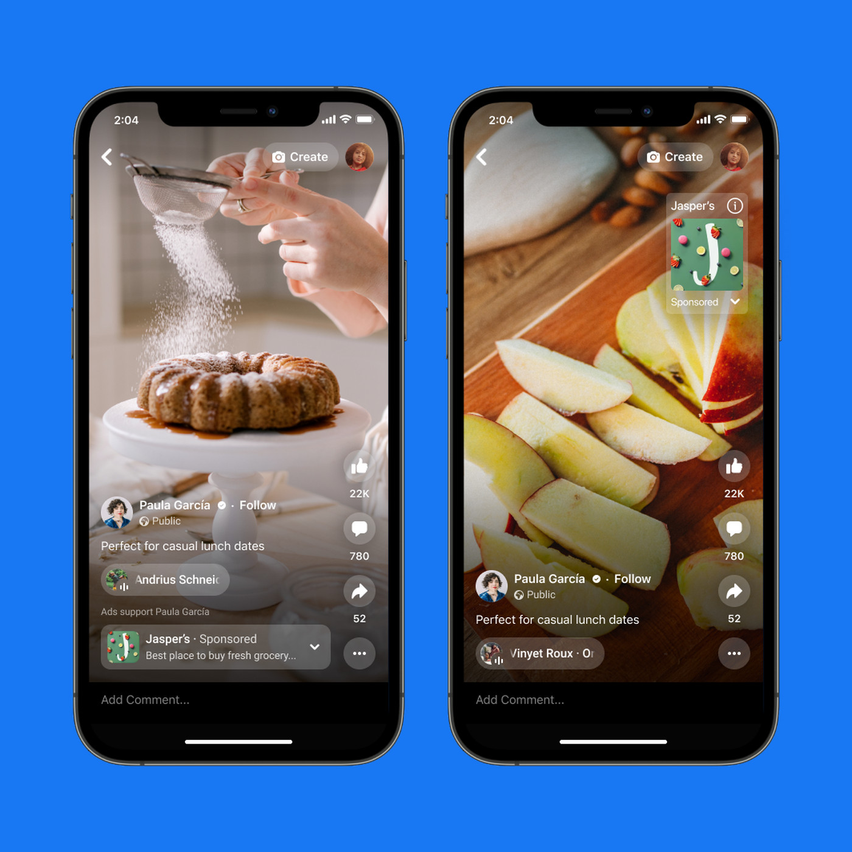
Facebook Reels
Reels on Facebook are a short-form video format for up to 90 seconds complete with music, audio, AR effects, and other options. Unlike Stories, you can share your reels publicly or with your friends or customers. A reel is made up of one or more video clips. Keep in mind, Reels can not be turned off. Reels are served to a wide public audience, and browsing reels are a great way to discover new businesses. https://www.facebook.com/help/398606435303267
The purpose of Facebook Reels is to deliver a new way to create short, entertaining videos, get discovered by new audiences, and be part of cultural moments on Facebook. Effects and music can be added to your reel or use your own original audio, allowing you to bring your ideas to life and share them with your audience.
NOTE. Reels versus Stories. Stories are only 15 seconds long; Reels are 6 times longer so allow for more in-depth content. Remember Reels can be discovered whereas Stories are only served to the creators' followers and friends hence the focus is put on Reels for mountain businesses.
https://www.facebook.com/

Slide 16

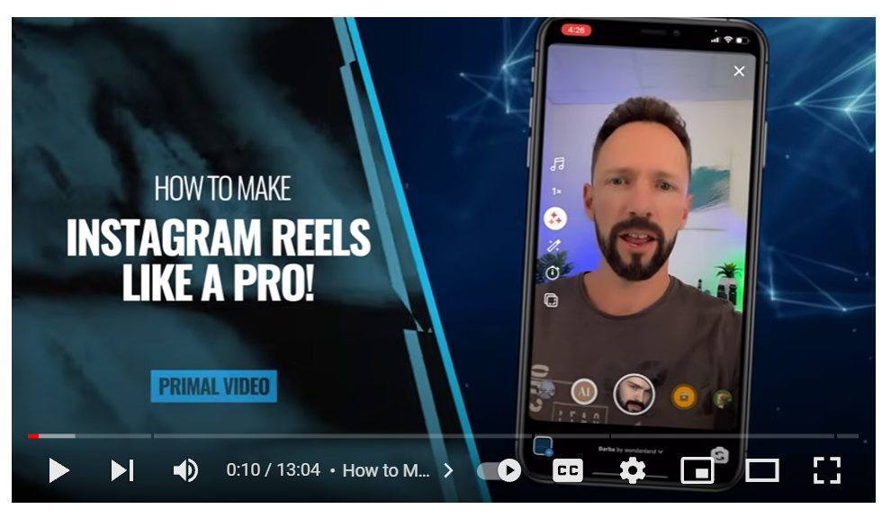
CLICK
TO VIEW
Instagram Reels Full Tutorial
https://www.youtube.com/watch?v=kdfau9slFIE
Ultra-Beginner Friendly
Instagram Reels are Instagram’s answer to TikTok’s shorter-form content. They’re super quick videos (up to 60 seconds in length), and can be a great way to engage with your viewers in a bite-sized format.
In this video, we'll show you step-by-step how to edit Instagram Reels like a PRO, how to use & post Reels, and simple tips to increase your views!
Time Stamps
00:00 How to Make Instagram Reels Like a PRO!
01:58 How to create reels on Instagram
07:58 How to create Instagram reels on 3rd party apps
09:10 Best editing apps for Instagram reels
12:43 How to create videos on your smartphone

Slide 17

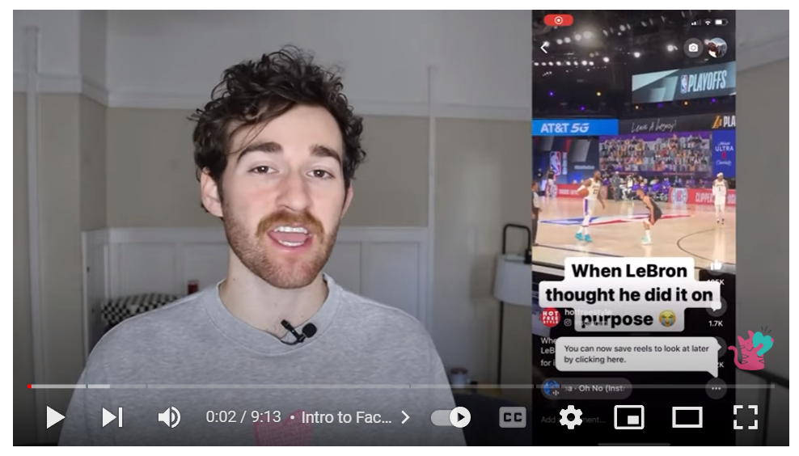

CLICK
TO VIEW
Facebook Reels Full Tutorial
https://www.youtube.com/watch?v=3aHHSMJL59o
Ultra-Beginner Friendly
With reels on Facebook, there is a new opportunity to share your content and reach an entirely different and wider audience. From this video learn how to use the Reels editor, make more precise edits to videos, and upload to Reels using the online video editor Kapwing.
Time Stamps
0:00 Intro to Facebook Reels
0:44 How to find the Reels studio on Facebook
1:27 Reels Recording and Editing Features (Lighting, Effects, Audio, Timer Editing, Green screen)
4:43 Finalizing Edit (Add music, text, subtitles)
6:15 Uploading a video to Reels
6:33 How to make more custom edits using Kapwing

Slide 18
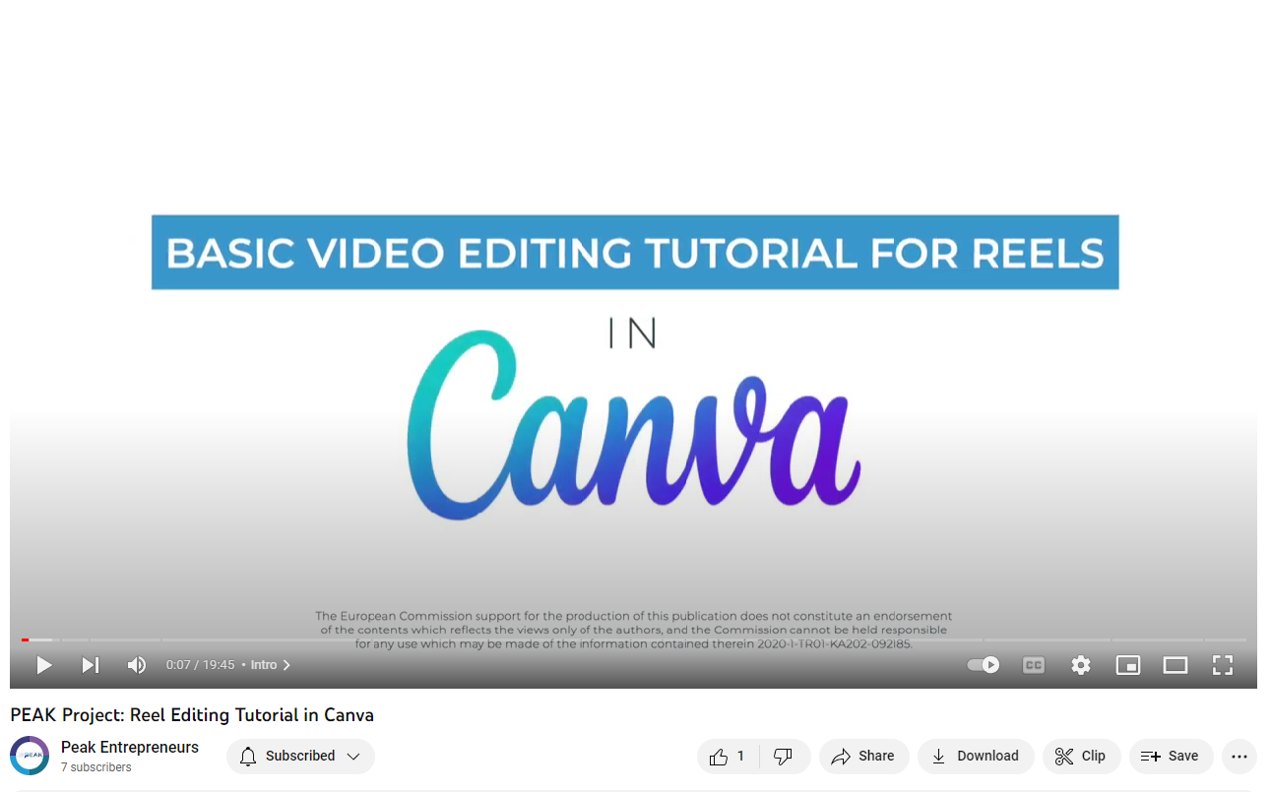
CLICK
TO VIEW
Basic Video Editing Tutorial to Create an Instagram or Facebook Reel
Using the Digital Tool Canva
This is a video tutorial explaining how to create a reel for Facebook and Instagram, using basic editing in Canva (https://www.canva.com).
00:00 - Intro
00:38 - Working in Canva
01:04 - Choosing the template
02:13 - Customising the template
05:38 - Adding footage to the timeline
10:22 - Adding transitions
11:40 - Adding music
13:33 - Adding text
15:32 - Adding a watermark logo
17:36 - Exporting the video file
19:05 - Ending

Slide 19

06
YouTube
For Young Mountain Entrepreneurs
www.youtube.com/
CLICK
TO VIEW VIDEOS

Slide 20

Why You Tube?
For Young Mountain Entrepreneurs
Reel in the Profits with YouTube
YouTube delivers more than a billion minutes of streaming content to 1.3 billion active users every day. That's equivalent to one-third of all internet users and at least a billion reasons to start creating videos that promote your business, brand, products, and services today. We know that travelers today have adjusted perceptions of what it means to go on a holiday. The shift away from the stock standard, routine holidays, and predictable destinations have begun.
As we know from the latest travel trends: destinations and styles the move has been towards creating unique, adventure-filled, landscape-inspired, travel experiences in lesser-known destinations.
This is where travel and tourism and farming brands can use YouTube; the largest video-based search engine, filled with inspiring and unique visual content just waiting to be discovered, to capture the attention of a very large travel audience. There are so many variations on how you can causally but effectively promote your business e.g., Vlogs, Travel Guide Videos, Niche Specific Videos. You can even evoke emotion through imagery and music
CLICK
TO VIEW VIDEOS

Slide 21
YouTube is Very Cost Effective and User Friendly
You don’t need to have a massive marketing budget or an in-house multi-media team to take advantage of YouTube. With a bit of imagination and creativity, your mountain business can produce video content that inspires, engages, and, ultimately, converts viewers into customers.
This is powerful stuff. Few small and medium-sized mountain businesses have yet to embrace a YouTube marketing strategy, despite its ever-growing popularity. As always, that means massive potential and profitability for those who do! This guide will show you how. If you’ve been hesitant to utilize YouTube marketing as a medium to distribute your travel content, here are a few reasons to reconsider embracing YouTube marketing today; Build Your Mountain or Travel Brand, Cultivate Relationships, Extend Your Audience Reach, Communicate Your Offering, Improve SEO and so much more.
The video marketing blueprint is you need to create videos that educate, entertain, and inspire viewers to take action. In this section you will learn how to plan, edit, promote, and share your videos with the public, as well as how to leverage YouTube's tools to help spotlight your business and your products without spending a fortune.
From video production to promotion, this guide shares the tried and tested strategies and provides valuable advice from successful YouTube experts to help you
Set up your channel, and learn how to build your brand so you can start reaping the benefits
Create a virtual audience and community that uses and loves your experiences and talks about them, shares fantastic content with you, and supports you e.g., sharing, vlogs
Cater video content that is tailored to your target audience so they are covered at every stage of the decision-making process
Drive traffic to your channel, website, or social media with optimized video titles, tags, playlists, and more
Promote your YouTube videos using Facebook, Twitter, Google+, and other social sites
Find out what a YouTube channel can do for you as you learn to create your channel, leverage it as a marketing tool, and maximize your return on investment.
Finally make sure to go to the PEAK YouTube Channel for inspiration and guidance.

Slide 22
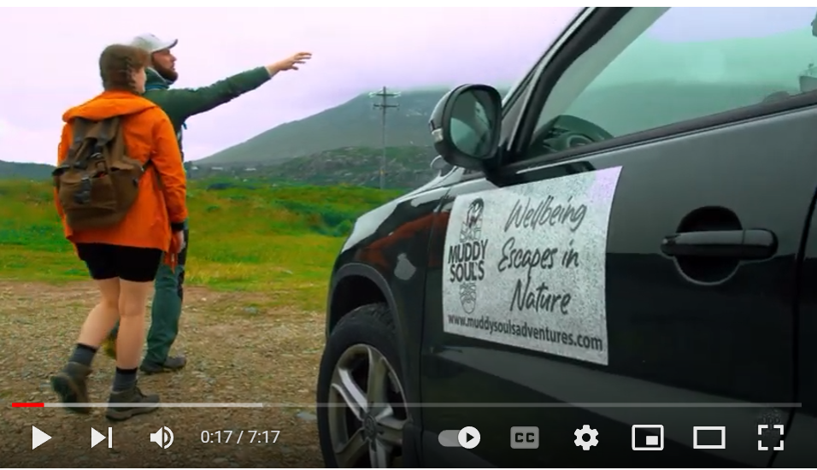
CLICK TO VIEW
PEAK Inspirational Tourism Videos Muddy Souls, Ireland, (Adventure Guide)
Muddy Souls, Ireland
Provides Wellbeing Escapes in nature to people across Ireland. Paul is the owner and an expert nature and mountain guide bringing people on amazing hikes up some of the most amazing Irish mountains. He also does nature walks and trails while at the same time helping people improve their mental health.
Connect with Muddy Soul’s
Website https://www.muddysoulsadventures.com/
Facebook https://www.facebook.com/muddysoulsad...
Instagram https://www.instagram.com/muddy_souls
The beginning of Muddy Souls and introduction to Paul (owner)
1:54 What Muddy Souls offers
2:25 How Muddy Souls has benefited its customers
5:10 Looking back on his first year of being in business
6:00 Invite to join Paul on one of his adventures
https://www.youtube.com/watch?v=-DOsvhb9zio&t=114s

Slide 23
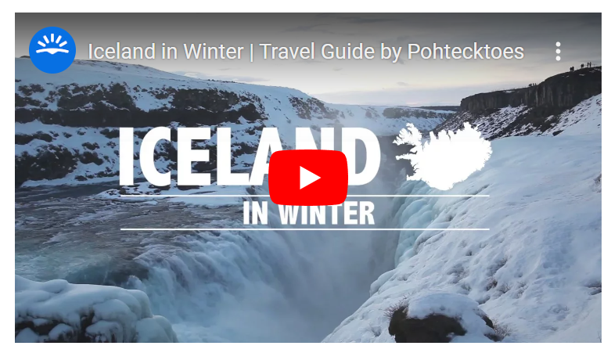
CLICK
TO VIEW
Example Travel Guide Video
https://youtu.be/xrHy2CcLpFE
Skyscanner and Iceland Tourism Video Interlinking Their Websites
Travel Guide Videos are a great way to create interest in a destination or travel product and should provide enough of a sensory experience for viewers to feel inspired to book with you. Tourism businesses can use YouTube data to analyse what their followers are searching for on the platform and additionally, to identify trending and emerging destinations. This information can then be translated into relevant promotions to drive traffic to their websites. According to a report made by Hitwise, Skyscanner put together a successful campaign based on Iceland’s status as an emerging destination.
Skyscanner published a travel guide video for Iceland on YouTube and reported a 59% increase in traffic from the platform to their travel website year-on-year. Full Article Here

Slide 24
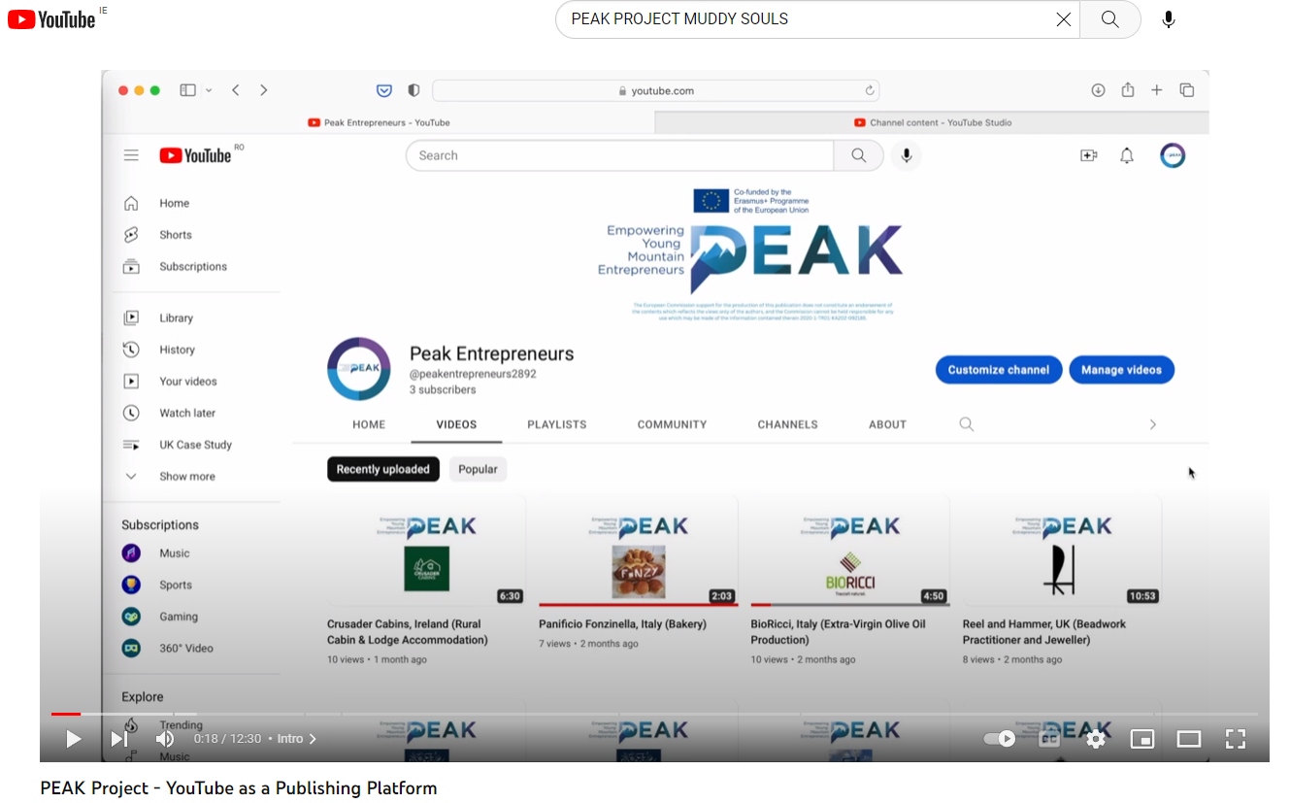

Basics Getting YouTube Channel Ready
For Tourism Businesses
Your business can use YouTube to address customer questions, promote brand messages, portray life at the office, and much more. The reach, engagement opportunity, and conversions are there; it's just a matter of getting started
SPECIAL INGREDIENTS to get the most out of your channel
Chose a NAME for your channel, make sure it aligns with your business or use your business name
Use HASHTAGS and make sure your SUBTITLES option is on
It is good to focus topics under a PLAYLIST e.g., for certain types of guests a playlist for Outdoor Enthusiasts, Elderly, Luxury, Green Focused
Create a CHANNEL TRAILER or PROMOTIONAL VIDEO and post it on YouTube. This should give a good overview of what you do answering the basic Why, Who, What, Where, When, How, and Why?
Start creating videos and make sure they are HIGH QUALITY, ENGAGING, and interesting to watch with a call to action.
Make sure to take advantage of your YouTube DESCRIPTION BOX so you can tell what your video is about and boost YouTube SEO.
Don’t forget to SHARE your videos on other channels and social media platforms.
CLICK TO VIEW
https://www.youtube.com/watch?v=fVbZAZUI3yk

Slide 25
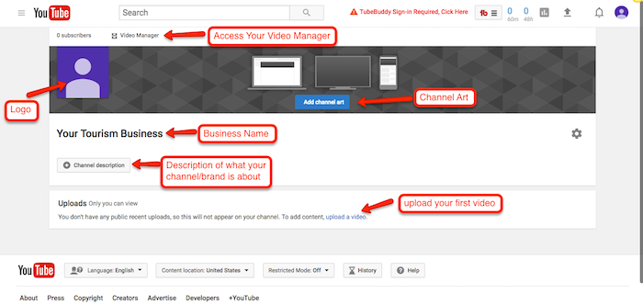
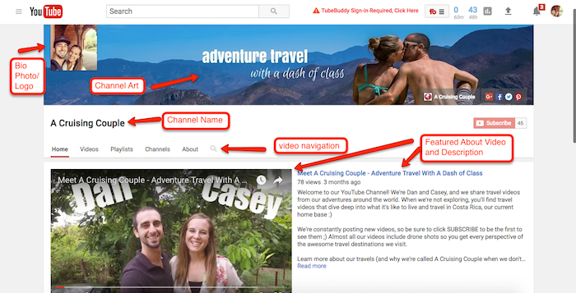
Time for ACTION!
Now Optimise Your YouTube Channel
Now that you know how to set up your YouTube channel, you can start to fill it out by adding your logo, channel art, channel description and uploading your featured about video and other travel videos!
Once you’ve started filling out your channel with awesome travel videos and organizing them into playlists, your channel will begin to look like this!
CLICK LINK

Slide 26
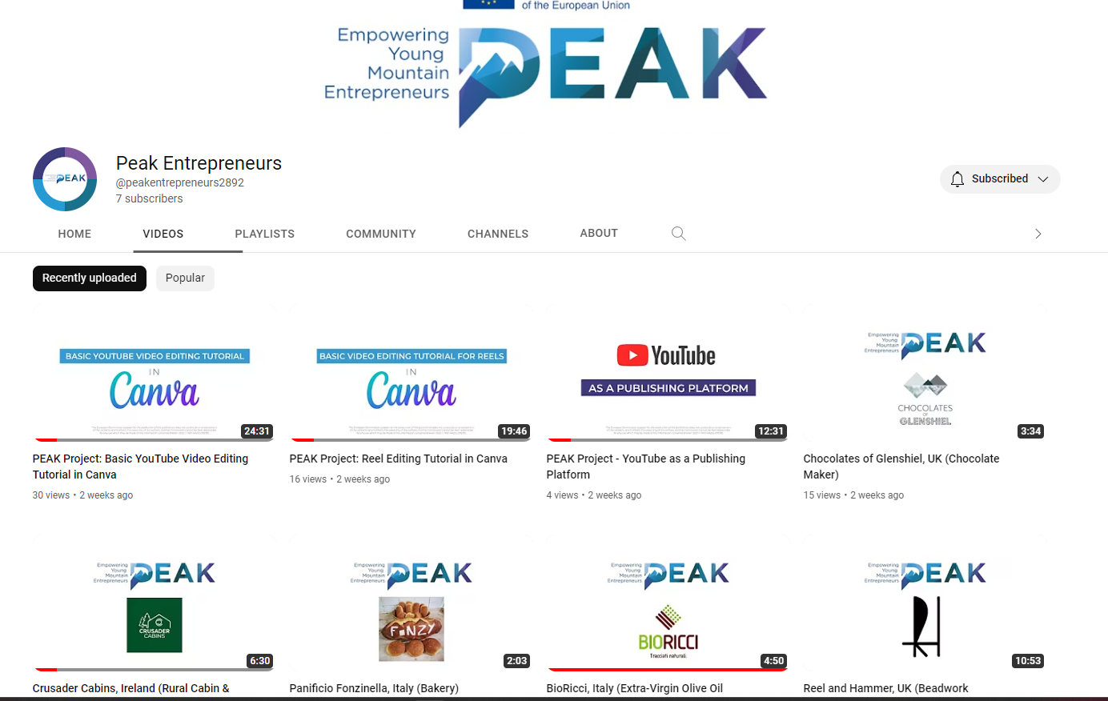
Learn from Other Young Mountain Entrepreneurs and Leaders
Loads of Videos Covering Content Specifically for Mountain Entrepreneurs
Every kind of mountain business from farming, wineries, tourism, bakeries, accommodation, jewellers, catering, gyms, guides, electric bike hire, olive oil production…and more.
Learn about their
Backgrounds and business ideas and why they started their business
Environmental initiatives
Sustainability practices
Innovative measures
How they reinvented themselves, particularly after hard times
Challenges faced and solutions they implemented
How they connect with the community and their environments
How they have diversified their products and experiences so they are aligned with the mountains and their customers

Slide 27
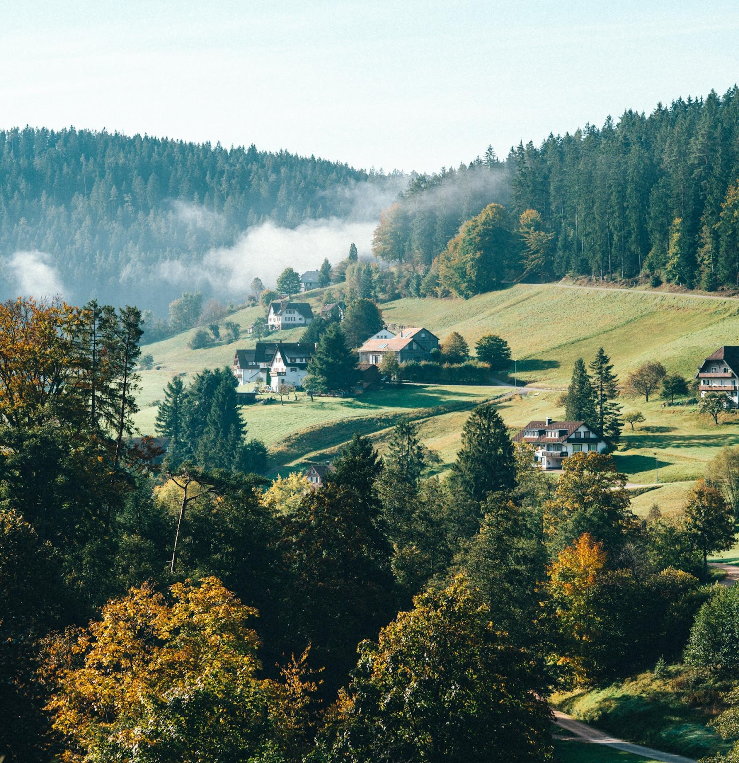

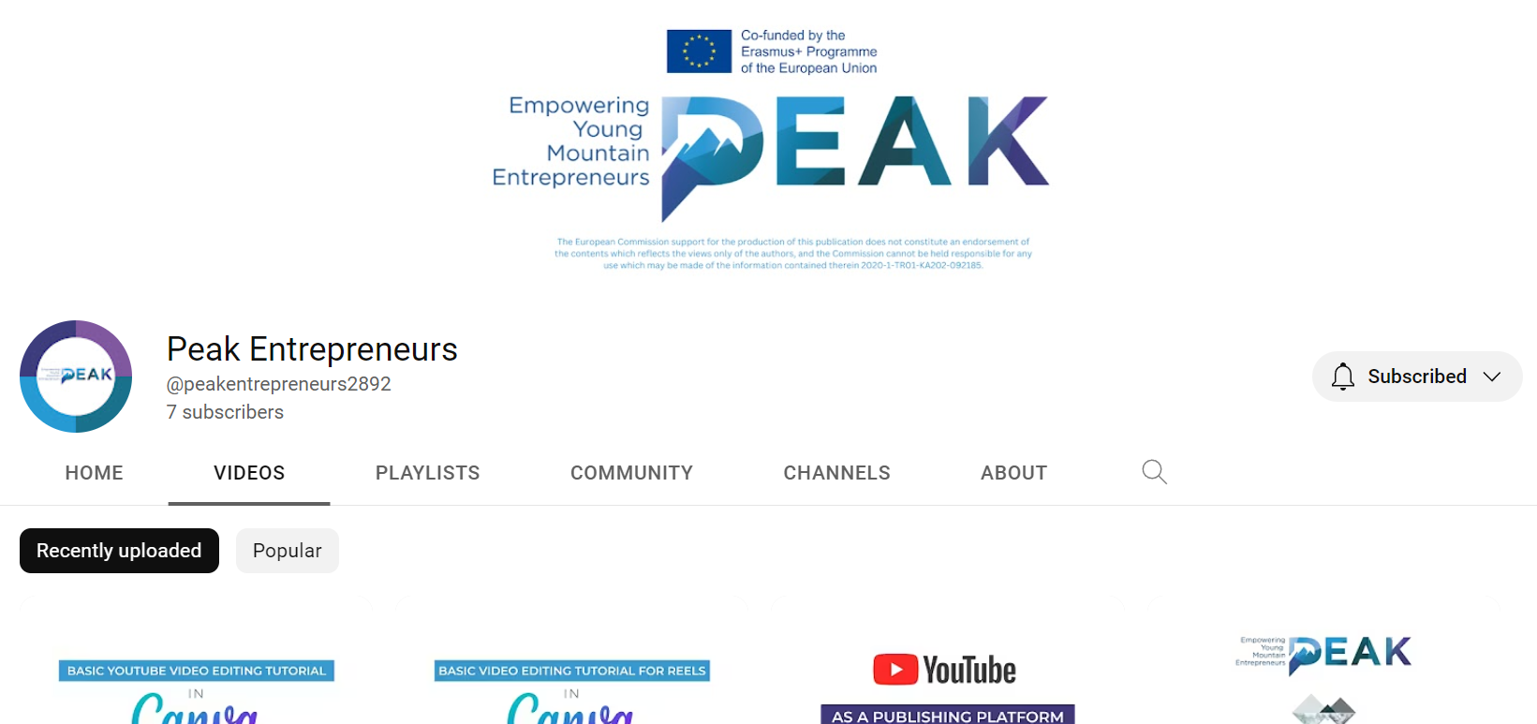

Hope You Enjoyed this Guide!
Make Sure to Connect with us on our Social Media and Communication Channels;
YouTube https://www.youtube.com/@PEAK695/videos
Website https://www.peakentrepreneurs.eu/
Facebook https://www.facebook.com/thePEAK..
Twitter https://twitter.com/ThePEAK1
Instagram https://www.instagram.com/thePEAK/
#erasmusplus #PEAKproject #sustainabletourism #europeanyouth #PEAKism
Follow our journey here
F
T
W
ig
yt

